Slide 1
Explicit Instruction:
Effective and Efficient Teaching
Anita L. Archer, Ph.D
April 10, 2024
STAR HE

Slide 2

Anita L. Archer, PHD
Author, Consultant, Teacher archerteach@aol.com
Archer, A., & Hughes, C. (2011). Explicit Instruction: Effective and Efficient Teaching. NY: Guilford Publications.
Videos that illustrate explicit instruction can be found on this website:
www.explicitinstruction.org

Slide 3
Active Participation during Session
Short Choral Responses - Muted
Structured Partners (1 and 2) - Pretend
Choral Reading - Muted
Cloze Reading - Muted
Hold-Ups
Make a response sheet.

Slide 4
“When you’re working on something that’s so critical to a life—to a child’s life—belief systems don’t cut it. Evidence cuts it.” —Dr. Reid Lyon
September 28, 2023

Slide 5
The Science of Reading
The Science of Learning
The Science
of Instruction
Evidence Base

Slide 6
The Science
of Instruction
How Teachers
Teach
How
Professors
Teach
Evidence Base

Slide 7
Purposes of Session
Participants will:
Prepare aspiring teachers to apply the Essential Elements of Explicit Instruction when teaching students.
Utilize the Essential Elements of Explicit Instruction when designing and delivering Teacher Preparation programs.

Slide 8

Learning for ALL
    Learning
    Learning
    Learning
    Learning
    Learning
    Learning

Slide 9
Learning for All
Teaching Learning
Teaching Learning
Teaching Learning
Teaching Learning
Teaching Learning
Teaching Learning
Teaching Learning

Slide 10
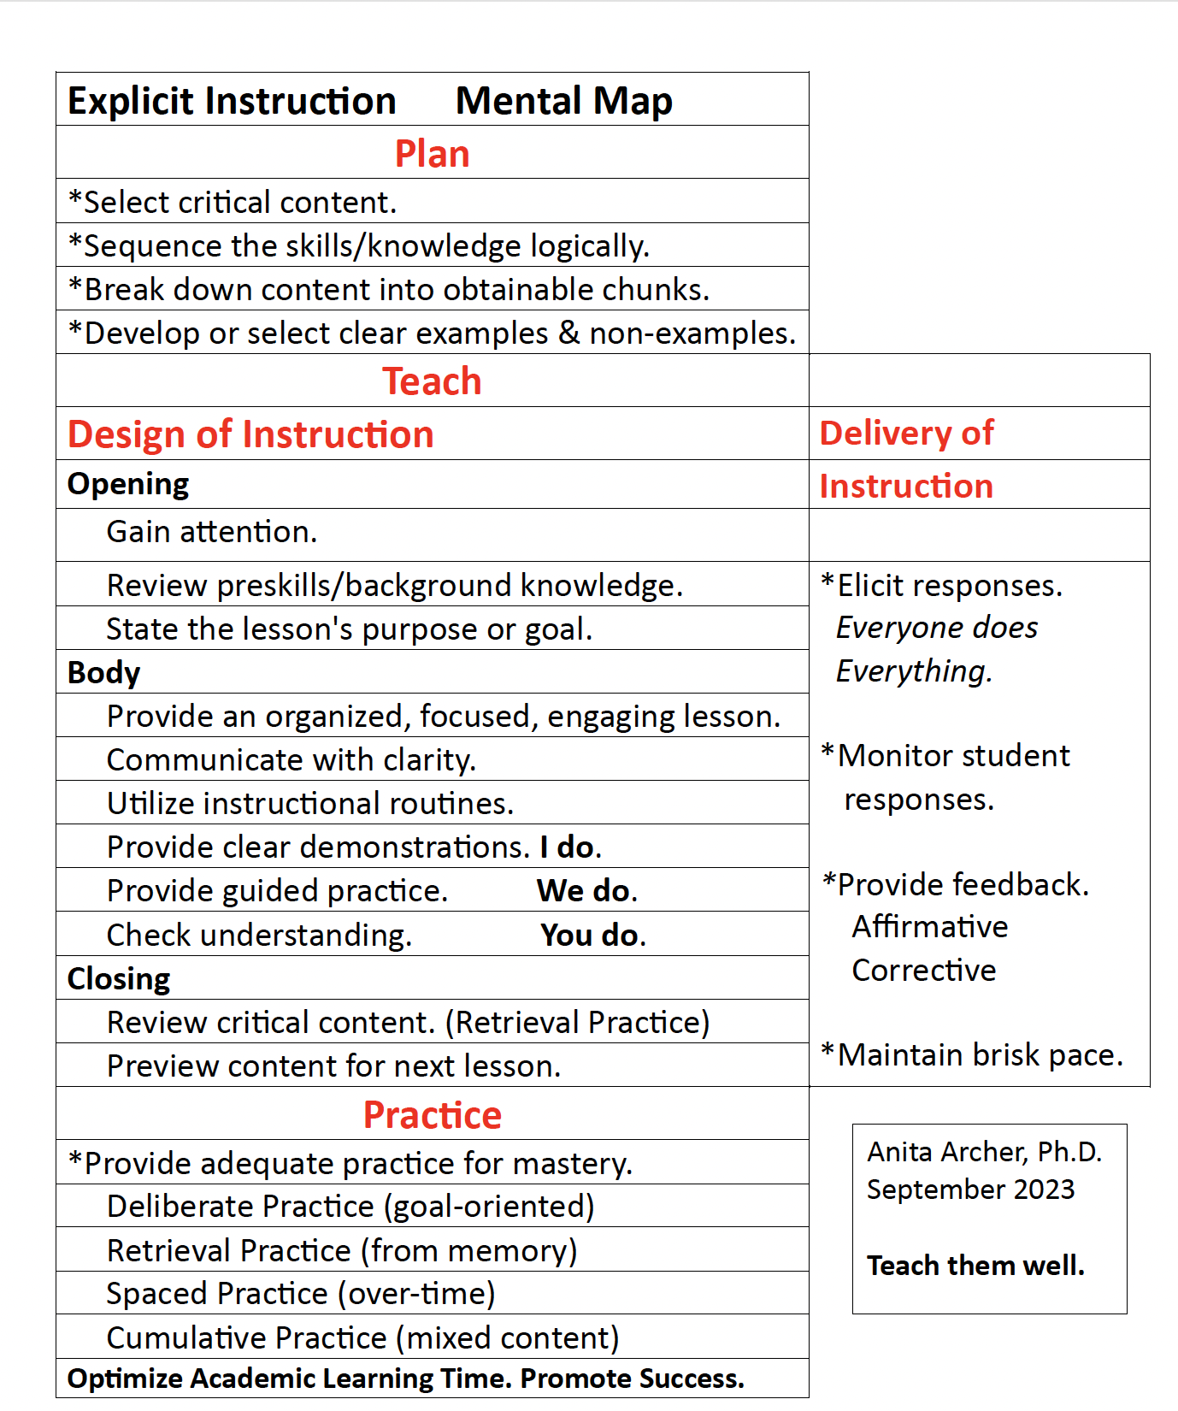

Slide 11
Elements of Explicit Instruction
Content

Slide 12
Elements of Explicit Instruction
Content
1. Focus on critical content.

Slide 13
1. Focus on critical content.
Critical Content
Select evidence-based content.
Archerism:
Teach the Stuff and Cut the Fluff.

Slide 14
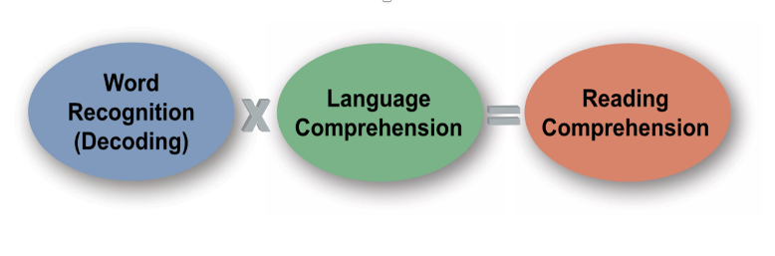
The Simple View of Reading
St. Martin, K., Vaughn, S., Troia, G., Fien, & H., Coyne, M. (2020). Intensifying literacy instruction: Essential practices. Lansing, MI: MiMTSS Technical Assistance Center, Michigan Department of Education. (Graphics)

Slide 15
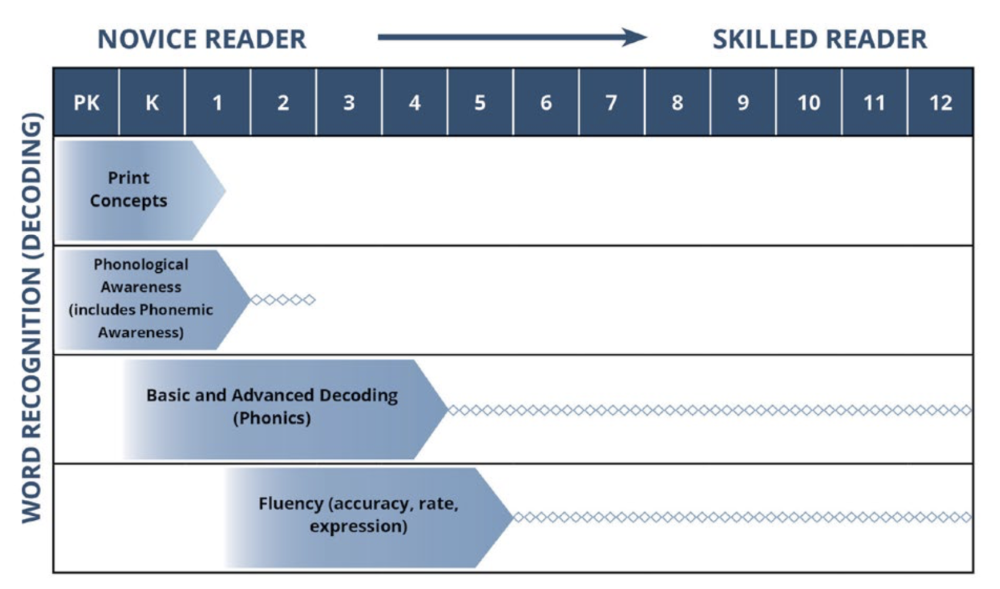


Slide 16
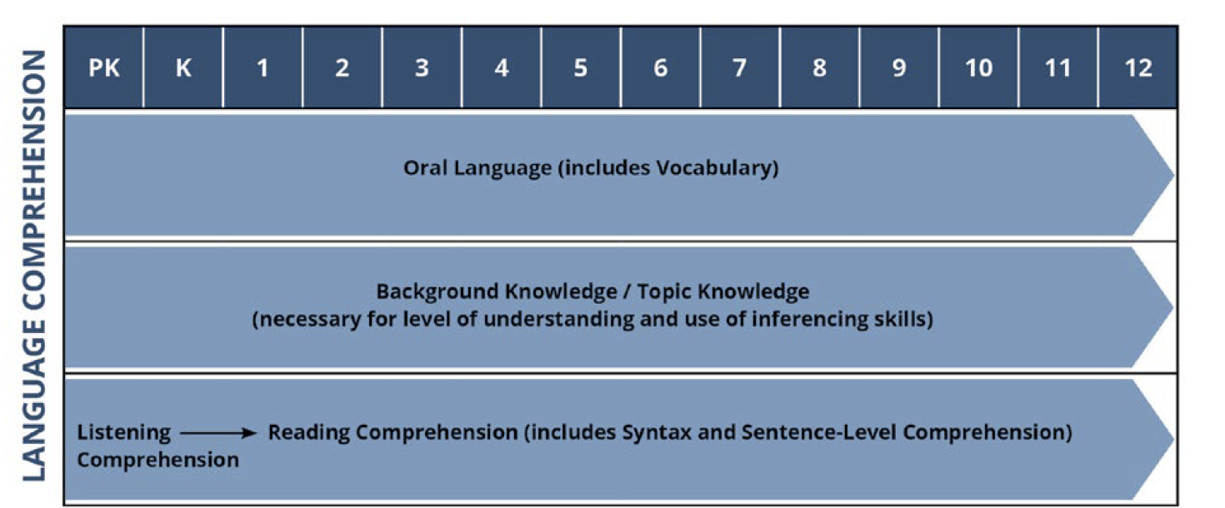

Slide 17
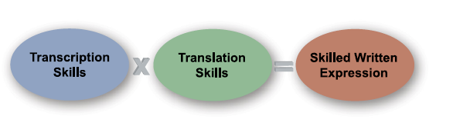
Simple View of Writing

Slide 18
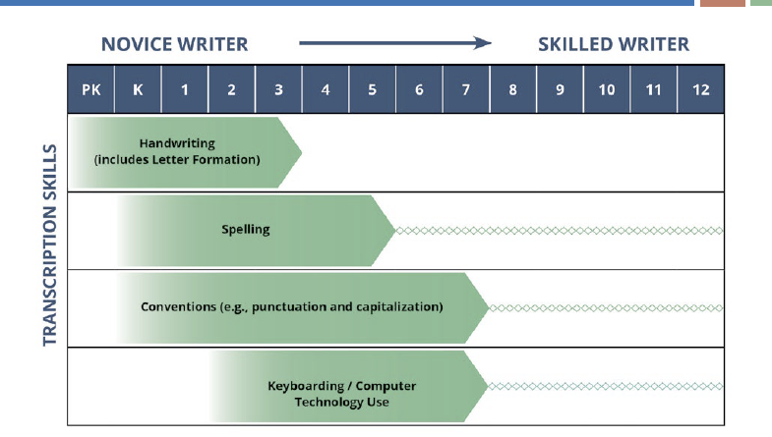

Slide 19
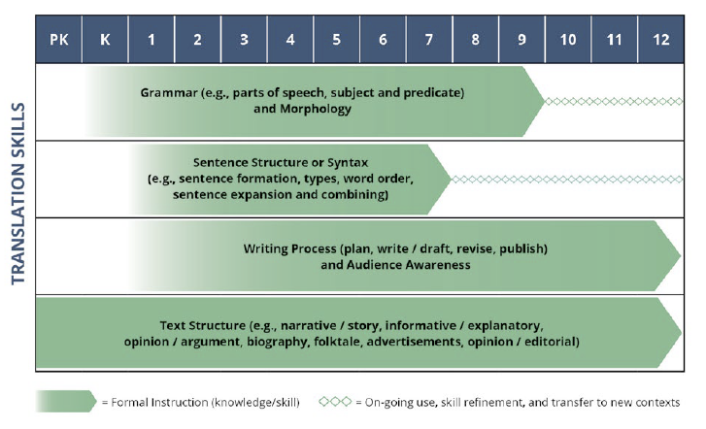

Slide 20
2. Break down material into smaller instructional steps (obtainable chunks) and systematically sequence steps.
Break-down Content
Carefully select resources.
IES Practice Guides
Textbooks
Demonstration Videos

Slide 21
IES Practice Guides
Foundational Skills to Support Reading for Understanding in Kindergarten Through 3rd Grade (2016)
Teach students to decode words, analyze word parts, and write and recognize words.
Teach students academic language skills, including the use of inferential and narrative language, and vocabulary knowledge.

Slide 22
IES Practice Guides
Teaching Academic Content and Literacy to English Learners in Elementary and Middle School (2014)
Teach a set of academic vocabulary words intensively across several days using a variety of instructional activities.
Teaching Elementary School Students to Be Effective Writers (2012)
Teach students to use the writing process for a variety of purposes.
Teach students to become fluent with handwriting, spelling, sentence construction, typing, and word processing.

Slide 23
IES Practice Guides
Improving Reading Comprehension in Kindergarten Through 3rd Grade (2010)
Teach students how to use reading comprehension strategies.
Teach students to identify and use the text’s organizational structure to comprehend, learn, and remember content.
Providing Reading Interventions for Students in Grades 4 – 9 (2022)
  Build students’ decoding skills so they can read complex multisyllabic words.
  Provide purposeful fluency-building activities to help students read effortlessly.
  Routinely use a set of comprehension-building practices to help students make sense of the text.

Slide 24
Elements of Explicit Instruction
Content
2. Break down material into smaller instructional steps (obtainable chunks) and systematically sequence steps.

Slide 25
2. Break down material into smaller instructional steps (obtainable chunks) and systematically sequence steps.
Break-down Content
Coursework - Science of Reading, Science of Writing, and Science of Instruction
Explicit Instruction
Word Recognition
Language Comprehension
Writing – Transcription Skills
Writing – Translation Skills
Practicum 1. Tutorial
Practicum 2. Classroom

Slide 26
Elements of Explicit Instruction
Design of Instruction

Slide 27
Elements of Explicit Instruction
Design of Instruction
3. Design organized and focused
lessons.

Slide 28
Elements of Explicit Instruction
Continuum of Lesson Planning
Scripted Intervention Program
Prepare
Read the script.
Rehearse the script
Study corrections
Teach with fidelity
Adjust next lesson based on student performance and assessment data
Tier 1 Annotated
Curriculum Manual
Prepare
Determine strands
Determine sequence of skills
For each lesson, annotate
Possible revisions
Add objective
Add student responses
Increase practice
Add corrections
Firm up
Design Lesson
Plan
Use when an existing, well-designed lesson in not available to annotate.
Include all elements of Explicit Instruction
Teach the lesson

Slide 29
3. Design organized and focused lessons.
Organized and focused lessons..
Teach organized and focused lessons on critical content in every session.
Archerism
How well you teach =
How well they learn

Slide 30
3. Design organized and focused lessons.
                1. Opening
                2. Body
                3. Closing

Slide 31
Elements of Explicit Instruction
Design of Instruction
Begin lessons with a clear statement of the lesson goals/purposes.

Slide 32
Elements of Explicit Instruction
Design of Instruction
5. Review prior skills and knowledge before
beginning instruction.

Slide 33
5. Review prior skills and knowledge before beginning instruction.
Review
Retrieval Practice:
When students retrieve and bring information to mind, this mental challenge produces durable long-term learning.
- Consistent instructional
practice
Actively involve students in review
Utilize retrieval practice (retrieve information from memory)
Recap VS Retrieval

Slide 34
5. Review prior skills and knowledge before beginning instruction.
Brain Drain
Five Minutes
Based on lectures, texts, articles, demonstrations, and webinars, write about vocabulary instruction evidence-based practices and routines.
Compare your draft with your partner.

Slide 35
Elements of Explicit Instruction
Design of Instruction – How to do something
6. Provide step-by-step demonstrations. (I do)

Slide 36
6. Provide step-by-step demonstrations. (I do)
I Do
Directly demonstrate the routine and/or
Watch and analyze an example video.
Demonstrations
Show and Tell
Exaggerate strategy steps
Clarity Clarity Clarity
Dynamic demonstrations followed by WE DO IT

Slide 37
Practice 1 (Professor Model)
Displayed on screen.
migrate
1. Introduce the word’s pronunciation.
This word is migrate. What word? migrate
Tap and say the syllables in migrate.
mi grate
Again. mi grate
What word? migrate
Spell migrate. m i g r a t e

Slide 38
Practice 1
Displayed on screen.
migrate
Introduce the word’s meaning.
Present a student-friendly explanation.
When birds or other animals move from one place to another at a certain time each year, they migrate. (Move your hand from one place to another to symbolize migrate. Have students do the action with the word migrate.)
So, if birds move from one place to a new place in the winter or spring, we say the birds _____________. migrate
Animals usually migrate to find a warmer place to live or to get food. When animals migrate, they move a long distance.

Slide 39
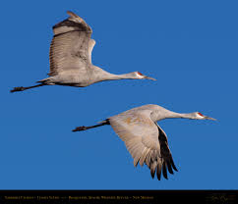
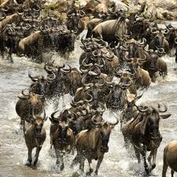
Practice 1
Illustrate the word with examples.
Sandhill Cranes fly from the North to the South so they can live in a warmer place.
Sandhill Cranes __________________. migrate
The wildebeests of Africa move to a new place so that they can find water and grass.
Wildebeests _________________. migrate

Slide 40
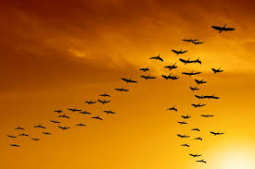
Practice 1
Check students’understanding.
(Deep processing question.)
Why do we say that birds who fly from tree to tree during the day don’t migrate?
Why do we say that birds who fly from Canada to Mexico when it gets cold migrate?

Slide 41
Practice 1
migrate
migration
migrant
Vaux Swifts migrate each autumn. Their migration begins in Canada and extends to Mexico. These tiny migrants seek warm weather.
5. Introduce word family.
Let’s learn additional words in the “migrate” word family. Notice that the words have similar spellings and meanings.
Echo read the words.
migrate migrate
migration migration
migrant migrant
I am going to read. When I stop, say the next word. (Read and discuss the paragraph.)

Slide 42
Elements of Explicit Instruction
Design of Instruction
7. Provide guided practice. (We do)

Slide 43
Practice 2 (Guided Practice – Let’s teach together)
Displayed on screen.
survive
Introduce the word’s pronunciation.
This word is survive. What word? survive
Tap and say the syllables in survive. sur vive
Again. sur vive
What word? survive

Slide 44
Practice 2
Displayed on screen.
survive
Introduce the word’s meaning.
Present a student-friendly explanation.
When people or animals don’t die when things are very bad or dangerous, they survive.
So when people or animals don’t die when things are very bad or dangerous, they __________. survive

Slide 45
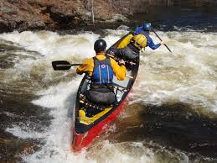
Practice 2
Illustrate the word with examples.
These people are paddling down a rapid river. Their trip is very dangerous. However, they don’t get hurt or die, they __________.
survive

Slide 46
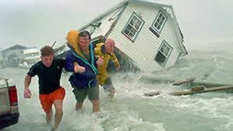
Practice 2
Illustrate the word with examples.
While the hurricane winds destroyed houses, cars, and stores, these residents did _______________. survive

Slide 47
Practice 2
Check students’ understanding.
(Examples and Non-Examples)
If the winter was very cold and all food was buried under snow, would whooping cranes survive? _______ no
Ones, tell your partner why they wouldn’t survive. Begin by saying: The whooping cranes would not survive because___.
If the whooping cranes had plenty of food and the weather was warm, would they survive? _____ yes
Twos, tell your partner why they would survive. Begin by saying: The whooping cranes would survive because ________.

Slide 48
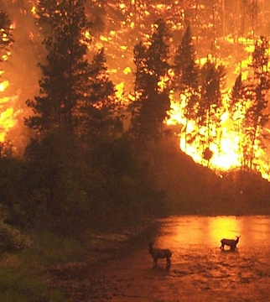
Practice 2 (Displayed on screen. See next slide for teacher instruction.)
Word Family – Extension
survive
survived
survival
survivors
Most animals did not survive the force of this forest fire. These elk survived the dangerous flames by escaping into a nearby river. Their survival was a miracle. They were some of the only survivors.

Slide 49
Practice 2
(Displayed on screen.)
Word Family – Extension
survive
survived
survival
survivors
Most animals did not survive the force of this forest fire. These elk survived the dangerous flames by escaping into a nearby river. Their survival was a miracle. They were some of the only survivors.
(Teacher instruction.)
Let’s learn additional words in the “survive” word family. Notice that the words have similar spellings and meanings.
Echo read the words.
survive survive
survived survived
survival survival
survivors survivors
I am going to read. When I stop, say the next word. (Read and discuss the paragraph.)

Slide 50
Elements of Explicit Instruction
Design of Instruction
8. Check for understanding before independent
practice. (You do)

Slide 51
Practice 3 (Partner Practice)
Displayed on screen.
abundant
Introduce the word’s pronunciation.
This word is abundant. What word? abundant
Tap and say the syllables. a bun dant
Again. a bun dant
What word? abundant

Slide 52
Practice 3
Displayed on screen.
abundant
Introduce the word’s meaning.
Present a student-friendly explanation.
When there is plenty of something, there is an abundant amount. So, if you have plenty of something, you have an amount that is ________. abundant
When you have a lot of something, there is an abundant amount. So, if you have a lot of something, you have an amount that is ___. abundant

Slide 53
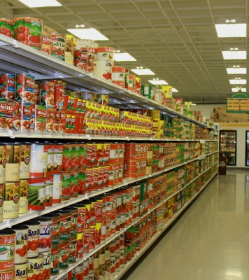
Practice 3
3. Illustrate the word
with examples.
This store has an abundant supply of canned food.

Slide 54



3. Illustrate with examples.
abundant pencils
not abundant

Slide 55
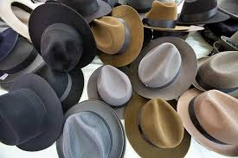
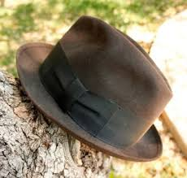
3. Illustrate with examples.
abundant hats
not abundant

Slide 56
Practice 3
4. Check Students’ understanding.
(examples and non-examples)
Get read to tell me if this would be abundant . Say abundant or not.
If you had 2 pencils for the school year? Not
If you had 40 pencils for the school year? Abundant
If your class had 800 books? Abundant
If the class had 8 books? Not
If the family had enough food for one day? Not
If the family had enough food for 3 months? Abundant

Slide 57
Practice 3
Check students’ understanding.
We would all like an abundant supply of some things. Make a list of things that you want in abundance. (Circulate and monitor. Record and share students’ ideas.)

Slide 58
Elements of Explicit Instruction
Delivery of Instruction

Slide 59
Elements of Explicit Instruction
Delivery of Instruction
Request frequent responses.
Opportunities to Respond Effect Size .79
Archerisms:
Learning is not a spectator sport.
Everyone does everything.

Slide 60
9. Request frequent responses.
Clear and Consistent Research Results:
Increases time on task
Increases academic achievement (Learning)
Decreases disruptive behaviors
Increases intensity of interventions
Research Review of 15 studies
Mac Suga-Gage & Simonsen, 2015

Slide 61
Opportunities to Respond
Guidelines for Response Rates – Current Research
(Mac Suga-Gage and Simonsen, 2015; Simonsen and Myers, 2015)
Effective teachers elicit:
Simple Responses
Such as: unison choral responses, gesture, response cards
3 to 5 opportunities to respond per minute
More Complex Responses
Such as: partner sharing, written answer, math problem
At least 1 opportunity to respond per minute
VERY Complex or Involved Responses
Such as: writing to prompt, completing experiment
May provide only 1 opportunity to respond every 10 to 30 min.

Slide 62
9. Request frequent responses.
Verbal Response Procedures Inclusive Passage Reading
Unison Choral Responses Silent Reading/Whisper Reading
Structured Partners Choral Reading
Teams/Huddle Groups Cloze Reading
Individual (limit)
Discussion Partner
Written Response Procedures Literacy Circles
Short Written Responses
Whiteboards (Tablets, Virtual Whiteboards)
Action Response Procedures Use of Technology
Acting out/Simulations
Touching/Pointing
Gestures
Facial Expressions
Hold-Ups
Hand Signals
Response Cards
Response Sheets

Slide 63
Elements of Explicit Instruction
Delivery of Instruction
10. Monitor student performance closely.

Slide 64
10. Monitor student performance closely.
Carefully monitor responses in class (and on assignments, tests)
Listen carefully
Look carefully
Circulate when necessary
  Walk Around
  Look Around
  Talk Around
ADJUST LESSON based on observations
Monitor
Student Performance

Slide 65
Elements of Explicit Instruction
Delivery of Instruction
Provide immediate affirmative, informative, and corrective feedback.

Slide 66
11. Provide immediate affirmative, informative, and corrective feedback.
Feedback
  Provide clear feedback
  To the entire group
  To individuals
  Archerism:
  Feedback feeds forward.
  Feedback feeds forward.

Slide 67
Elements of Explicit Instruction
Delivery of Instruction
Deliver the lesson at a brisk pace.
Archerism:
Perky NOT pokey.

Slide 68
Elements of Explicit Instruction
Practice

Slide 69
Elements of Explicit Instruction
Practice
Provide judicious practice.

Slide 70
Judicious Practice
Practice within class sessions
Practice with peers outside of class
Extra Practice Sessions with Instructor
Practicum #1 Tutoring
(Utilizing evidence-based intervention )
Practicum # 2 Classroom Teaching
(Settings that utilize an evidence-based core program)

Slide 71
Topic
Content | 1. Focus on Critical Content.
 | 2. Break down new material into smaller steps (obtainable chunks).
Design | 3. Design organized and focused lessons.
 | 4. Begin lessons with a clear statement of the lesson goals.
 | 5.Review prior skills and knowledge before beginning instruction.
 | 6. Provide step-by-step demonstrations. I do.
 | 7. Provide guided practice. We do.
 | 8. Check students’ understanding. You do.
Delivery | 9. Request frequent responses.
 | 10. Monitor student performance.
 | 11. Provide immediate affirmative (praise) and informative (corrective) feedback.
 | 12. Deliver the lesson at a brisk pace.
Practice | 13. Provide judicious practice.

Slide 73
Thank you for your dedication to quality teacher education so that all children can read and write with ease.
I slept and dreamt that life is joy.
I awoke and saw that life was service.
I acted and behold, service was joy.
Rabindranath Tagore

Slide 74
Resources
Websites
https://www.readingscience.org/higher-education
https://www.safeandcivilschools.com/upcoming-events
https://www.jessicatoste.com/wordconnections
https://www.marshall.edu/eltac/resources/west-virginia-phonics/
https://www.readingscience.org/preschool
https://www.facebook.com/StephanieStollarConsulting
https://explicitinstruction.org/
https://www.voyagersopris.com/blog/edview360/learning-is-not-a-spectator-sport
https://iris.peabody.vanderbilt.edu/module/bi2-elem/cresource/q1/p06/
https://home.edweb.net/webinar/literacyhero20240409/
https://www.readingscienceacademy.com/DirectInstruction
https://www.thereadingleague.org/compass/educator-preparation-programs/
Documents
https://education.ohio.gov/getattachment/Topics/Learning-in-Ohio/Literacy/Ohios-Plan-to-Raise-Literacy-Achievement.pdf.aspx
https://education.ohio.gov/getattachment/Topics/Learning-in-Ohio/Literacy/Dyslexia/Ohio_s-Dyslexia-Guidebook.pdf.aspx?lang=en-US
https://www.thereadingleague.org/what-is-the-science-of-reading/defining-guide-ebook/
https://ies.ed.gov/ncee/wwc/PracticeGuides
https://ies.ed.gov/ncee/edlabs/regions/southeast/pdf/REL_2021060.pdf

