Slide 1
A Virtual Dyslexia Module for K-2 Pre-Service Educators
Center for Reading Science Webinar
February 26, 2024
Karen F. Kehoe, Ph.D.
Director

Slide 2
CONTEXT
2016: “Say Dyslexia” Law
Implement universal screening for characteristics of dyslexia through RTI²
Determine students demonstrating characteristics of dyslexia
Parent notification
Dyslexia-specific intervention through RTI² framework
Progress monitoring
Source: Tennessee Department of Education,
Say_Dyslexia_District_Info_Sheet.pdf (tn.gov)
Notes:
Want to give a context for the

Slide 3
CONTEXT
2021: Tennessee Literacy Success Act
Universal screening
Parent notification, dyslexia-specific intervention through RTI²
Teacher training
Complete $≥$1 state-approved course in foundational literacy skills
License renewal
Source: Tennessee Department of Education,
Literacy.pdf (tn.gov)
Notes:
Screening:
3 x / year in K-3 (fall, winter, spring)
8 approved screeners, including a free, state screener
Schools, districts must report results to state
Parent notification
Another law in 2021: Tennessee Learning Loss Remediation and Student Acceleration Act – 3rd grade retention based on TCAP but with options to avoid it through summer camps, intensive tutoring

Slide 4
CONTEXT
2021: Tennessee Literacy Success Act
Universal screening
Parent notification, dyslexia-specific intervention through RTI²
Teacher training
Complete $≥$1 state-approved course in foundational literacy skills
License renewal
Foundational skills instruction Foundational Literacy Skills Plans
Source: Tennessee Department of Education,
Literacy.pdf (tn.gov)
Notes:
Screening:
3 x / year in K-3 (fall, winter, spring)
8 approved screeners, including a free, state screener
Schools, districts must report results to state
Parent notification
Another law in 2021: Tennessee Learning Loss Remediation and Student Acceleration Act – 3rd grade retention based on TCAP but with options to avoid it through summer camps, intensive tutoring

Slide 5
Foundational Literacy Skills Plans
“Each district and charter school plan must cover grades K-5 and include the following six sections:
• the amount of daily time devoted to foundational literacy skills instruction and how that time is utilized,
• ELA textbooks and instructional materials adopted,
• the universal reading screener selected by the district or charter school,
• a description of reading interventions and supports available to students with a significant reading deficiency,
• how the district or charter school intends to notify and engage parents in the student literacy process, and
• how the district or charter school will provide professional development in foundational literacy skills to K-5 teachers” (p. 16).
Source: Tennessee Department of Education,
Literacy.pdf (tn.gov)
Notes:
Screening:
3 x / year in K-3 (fall, winter, spring)
8 approved screeners, including a free, state screener
Schools, districts must report results to state
Parent notification
Another law in 2021: Tennessee Learning Loss Remediation and Student Acceleration Act – 3rd grade retention based on TCAP but with options to avoid it through summer camps, intensive tutoring

Slide 6
CONTEXT
2021: Tennessee Literacy Success Act
Universal screening
Parent notification, dyslexia-specific intervention through RTI²
Teacher training
Complete $≥$1 state-approved course in foundational literacy skills
License renewal
Foundational skills instruction Foundational Literacy Skills Plans
Revised standards for Educator Preparation Programs (E.P.P.’s)
Source: Tennessee Department of Education,
Literacy.pdf (tn.gov)
Notes:
Screening:
3 x / year in K-3 (fall, winter, spring)
8 approved screeners, including a free, state screener
Schools, districts must report results to state
Parent notification
Another law in 2021: Tennessee Learning Loss Remediation and Student Acceleration Act – 3rd grade retention based on TCAP but with options to avoid it through summer camps, intensive tutoring

Slide 7
2021 E.P.P. Literacy Standards for EC, Elementary, Special Ed.
Standard 1: Content Knowledge
Standard 2: Language & Literacy Rich Environment
Standard 3: High-Quality Instructional Materials & Lesson Preparation
Standard 4: Instruction Using High-Quality Instructional Materials
Standard 5: Foundational Literacy Skills Assessment & Evaluation
Standard 6: Professional Learning & Leadership
Standard 7: Trauma-Informed Concepts
Standard 8: Trauma-Informed Discipline Practices
Source: Tennessee Department of Education,
2017-2021_EPP_Literacy_Standards_Comparison-_upd-4-18.pdf (tn.gov))
Notes:
Revised from the 2017 standards
Bolded = new standards

Slide 8
2021 E.P.P. Literacy Standards for EC, Elementary, Special Ed.
Standard 1: Content Knowledge
Standard 2: Language & Literacy Rich Environment
Standard 3: High-Quality Instructional Materials & Lesson Preparation
Standard 4: Instruction Using High-Quality Instructional Materials
Standard 5: Foundational Literacy Skills Assessment & Evaluation
Standard 6: Professional Learning & Leadership
Standard 7: Trauma-Informed Concepts
Standard 8: Trauma-Informed Discipline Practices
Source: Tennessee Department of Education,
2017-2021_EPP_Literacy_Standards_Comparison-_upd-4-18.pdf (tn.gov))
Notes:
Bolded = new standards

Slide 9
2021 E.P.P. Literacy Standards for EC, Elementary, Special Ed.
Standard 1: Content Knowledge
Standard 2: Language & Literacy Rich Environment
Standard 3: High-Quality Instructional Materials & Lesson Preparation
Standard 4: Instruction Using High-Quality Instructional Materials
Standard 5: Foundational Literacy Skills Assessment & Evaluation
Standard 6: Professional Learning & Leadership
Standard 7: Trauma-Informed Concepts
Standard 8: Trauma-Informed Discipline Practices
Source: Tennessee Department of Education,
2017-2021_EPP_Literacy_Standards_Comparison-_upd-4-18.pdf (tn.gov))
Notes:
Blue = Revised from the 2017 standards

Slide 10
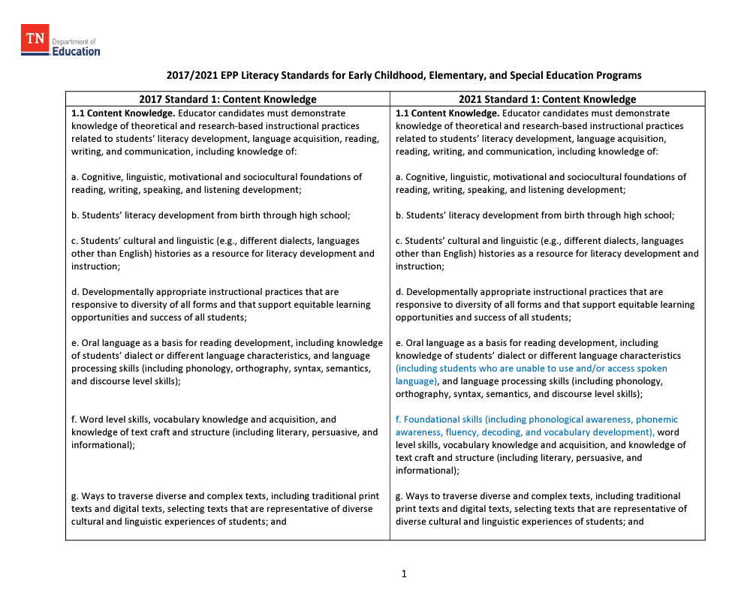
Notes:
In blue text are some of the key revisions

Slide 11
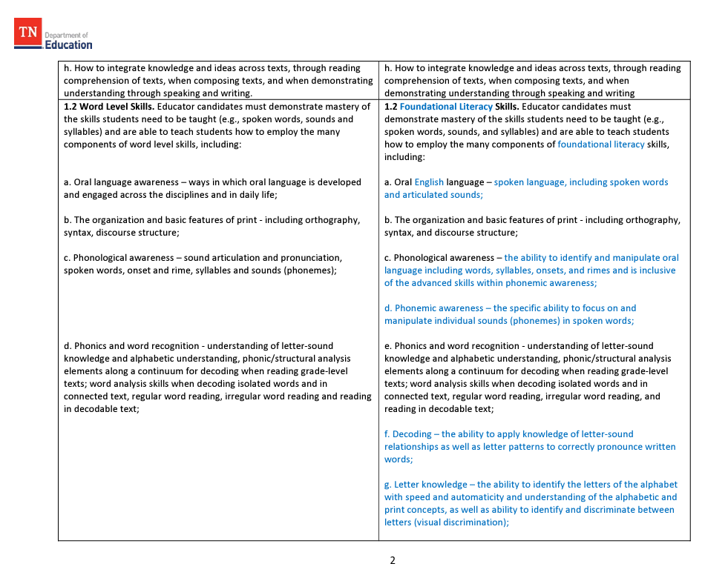
Notes:
In blue text are some of the key revisions

Slide 12
PRIMARY GOALS
Support our COE in implementing LSA requirements
Prepare pre-service teachers to comply with TN legislation
Integrate rather than add on
Notes:
So it is within this context that we began working with the Department of Elementary and Special Education in our College of Education.

Slide 13
Steps to implementation
Planning meetings
Module development
Instructor’s guide
Learning
assessments
Technical assistance
Course sequence
Goals
Feasibility
Specific foci
Digestible chunks
Flexibility
Parallel structure
Interactive
No guesswork
Pre- / Post
Chapter quizzes
Learning checks
Format
Post-implementation meeting
Notes:
Planning meetings – we had to 1) understand their course sequence; 2) understand their needs & goals; 3) talk about format

Slide 14
COURSE OVERVIEW
Chapter 1: The Science of Reading
Section 1.1: Defining the Science of Reading
Section 1.2: The Components of Reading
Section 1.3: Reading in the Brain
Section 1.4: Structured Literacy
Chapter 2: Overview of Dyslexia
Section 2.1: The Evolution of Dyslexia and the Language Shift
Section 2.2: The Neurobiological Basis of Dyslexia
Section 2.3: Characteristics of Dyslexia
Section 2.4: Prevention and Risk Indicators of Dyslexia
Chapter 3: Screening for Dyslexia
Section 3.1: MTSS and the Problem-Solving Model
Section 3.2: Screening for Risk in Kindergarten
Section 3.3: Screening for Dyslexia After Kindergarten
Chapter 4: Intervention
Section 4.1: Cracking the Code: What’s Our Language Made Of?
Section 4.2: Getting it to Stick: Orthographic Mapping
Section 4.3: Phonological Awareness and Letter Knowledge
Section 4.4: Basic Decoding
Section 4.5: Handwriting and Encoding/Spelling Instruction
Section 4.6: Language Comprehension

Slide 15
chapter 4 overview
Chapter 4: Intervention
Section 4.1: Cracking the Code: What’s Our Language Made Of?
Section 4.2: Getting it to Stick: Orthographic Mapping
Section 4.3: Phonological Awareness and Letter Knowledge
4.3A Phonological Awareness
4.3B PA and Letter Name Knowledge
4.3C Intensifying Instruction
Section 4.4: Basic Decoding
4.4A Sound-Symbol Relationships
4.4B Word Reading Accuracy and Automaticity
4.4C High-Frequency Word Reading and Decodable Text
4.4D Intensifying Instruction
Section 4.5: Handwriting and Encoding/Spelling Instruction
Section 4.6: Language Comprehension

Slide 16
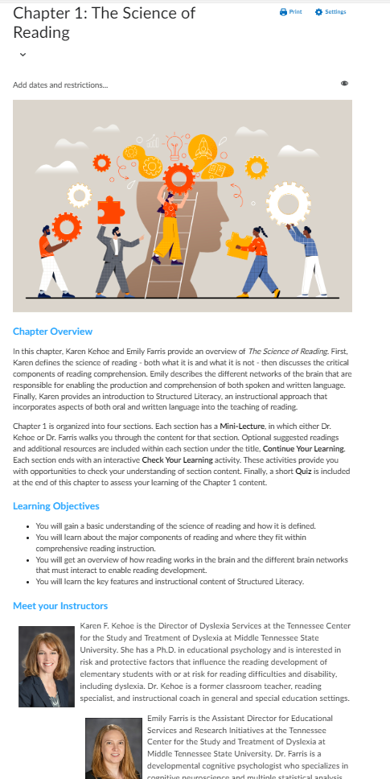

Slide 17
chapter 1 overview
Chapter 1: The Science of Reading
Section 1.1: Defining the Science of Reading
Section 1.2: The Components of Reading
Section 1.3: Reading in the Brain
Section 1.4: Structured Literacy
Chapter 1 Quiz

Slide 18
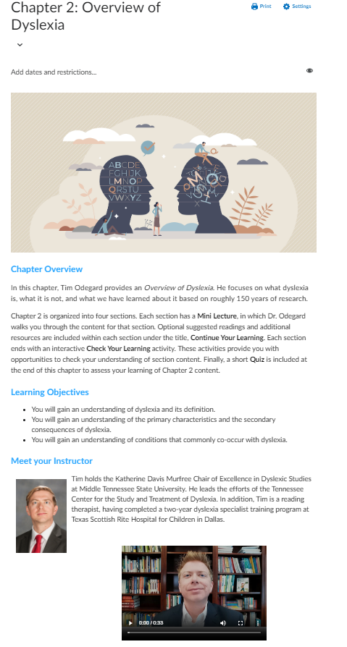

Slide 19
chapter 2 overview
Chapter 2: Overview of Dyslexia
Section 2.1: The Evolution of Dyslexia and the Language Shift
Section 2.2: The Neurobiological Basis of Dyslexia
Section 2.3: Characteristics of Dyslexia
Section 2.4: Prevention and Risk Indicators of Dyslexia
Chapter 2 Quiz

Slide 20
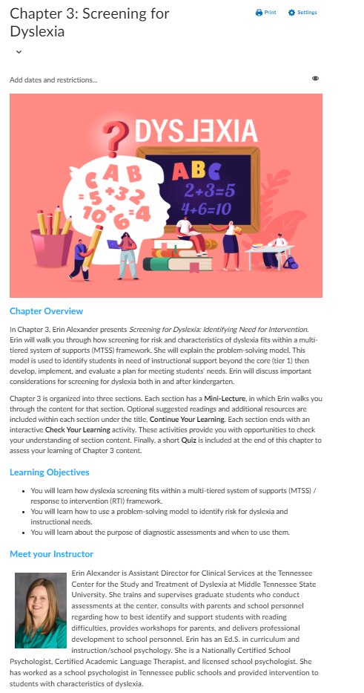

Slide 21
chapter 3 overview
Chapter 3: Screening for Dyslexia
Section 3.1: MTSS and the Problem-Solving Model
Section 3.2: Screening for Risk in Kindergarten
Section 3.3: Screening for Dyslexia After Kindergarten
Chapter 3 Chapter 3 Quiz

Slide 22
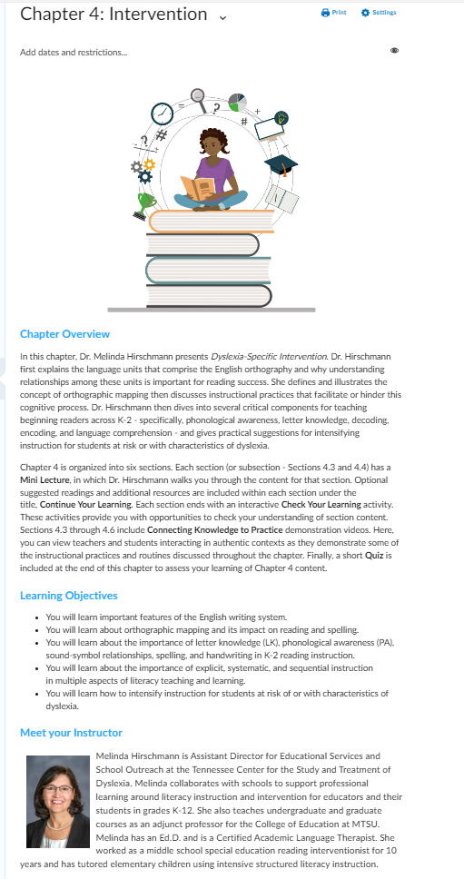

Slide 23
chapter 4 overview
Chapter 4: Intervention
Section 4.1: Cracking the Code: What’s Our Language Made Of?
Section 4.2: Getting it to Stick: Orthographic Mapping
Section 4.3: Phonological Awareness and Letter Knowledge
4.3A Phonological Awareness
4.3B PA and Letter Name Knowledge
4.3C Intensifying Instruction
Section 4.4: Basic Decoding
4.4A Sound-Symbol Relationships
4.4B Word Reading Accuracy and Automaticity
4.4C High-Frequency Word Reading and Decodable Text
4.4D Intensifying Instruction
Section 4.5: Handwriting and Encoding/Spelling Instruction
Section 4.6: Language Comprehension
Chapter 4 Quiz

Slide 24
Section components
Mini Lecture
Continue Your Learning
Check Your Learning

Slide 25
additional component:
Sections 4.3A – 4.4D
Connecting Knowledge to Practice

Slide 26
Mini Lecture

Slide 27
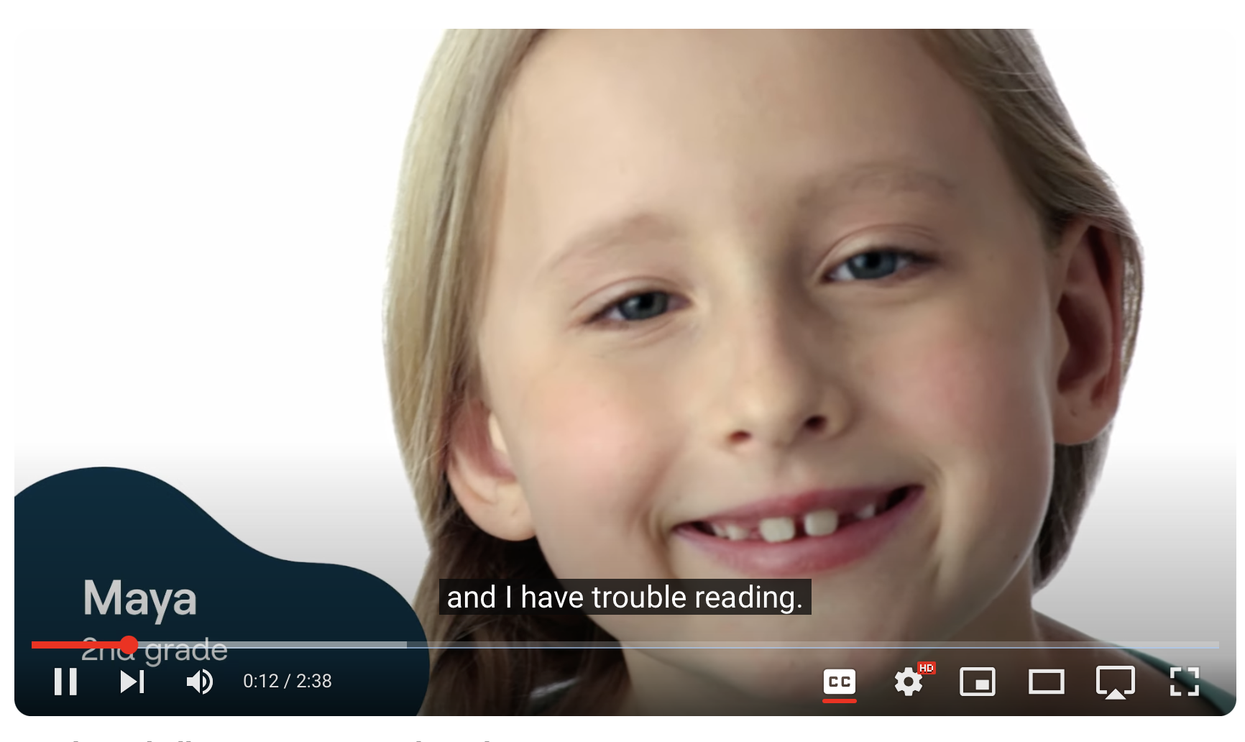
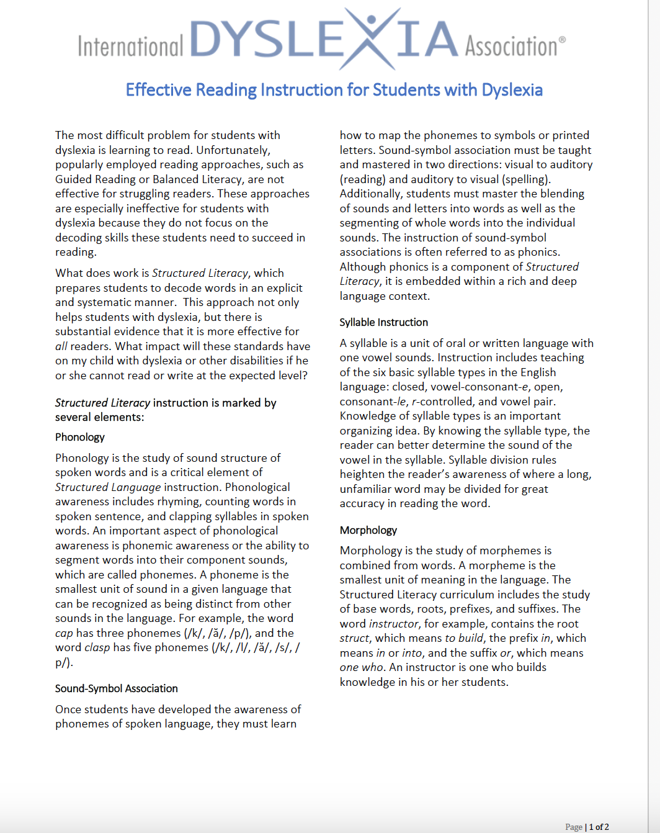
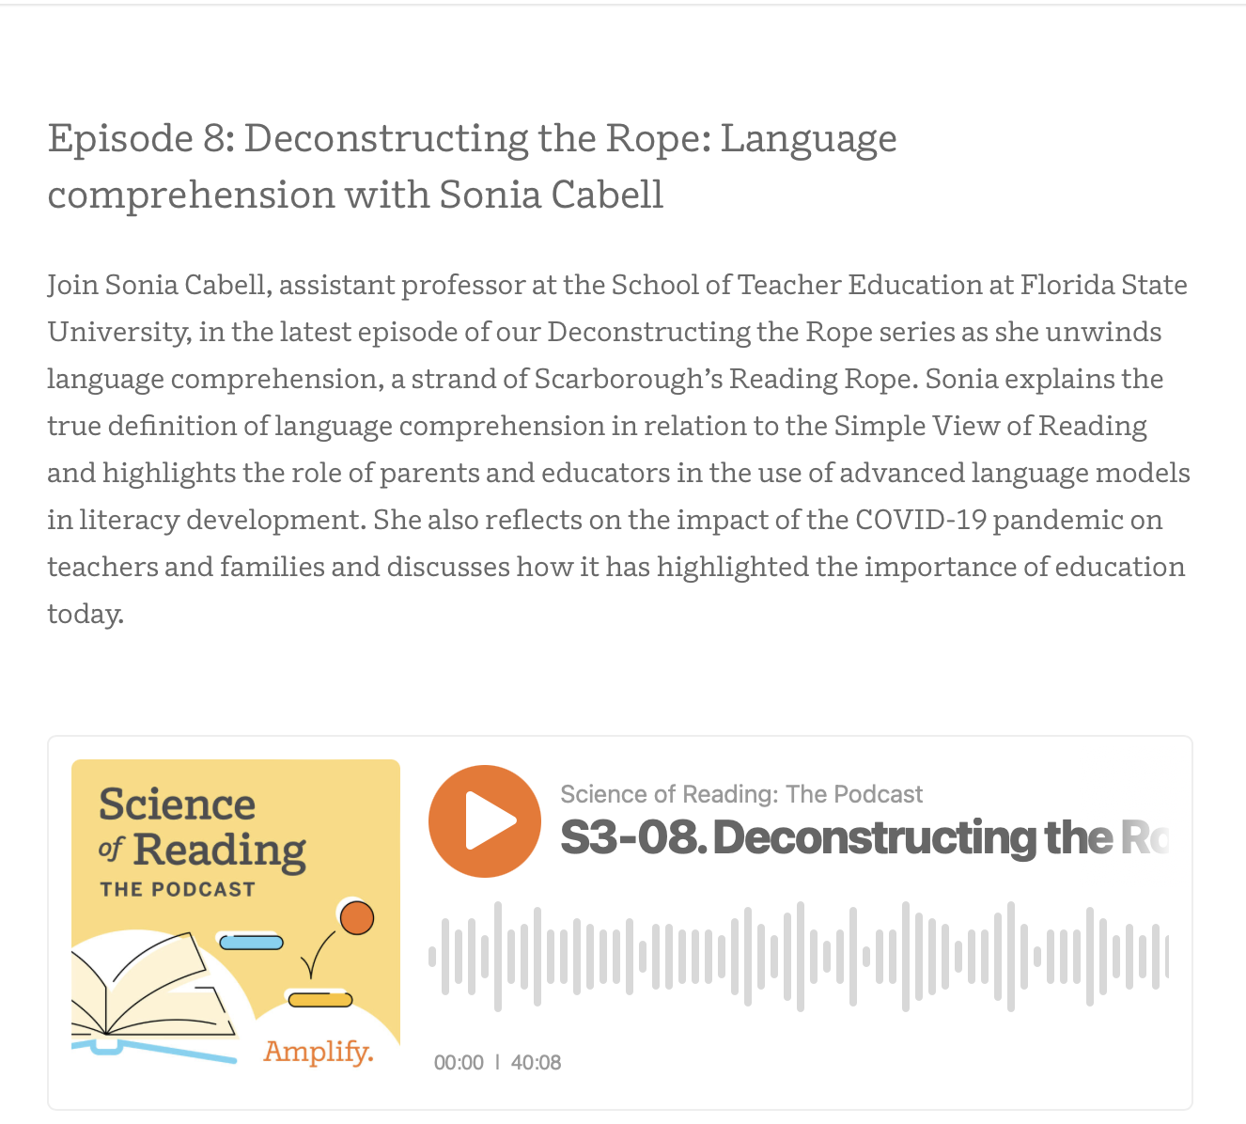
Continue Your Learning
News Media
Videos
Trusted Resources
Podcasts
Journal Articles

Slide 28
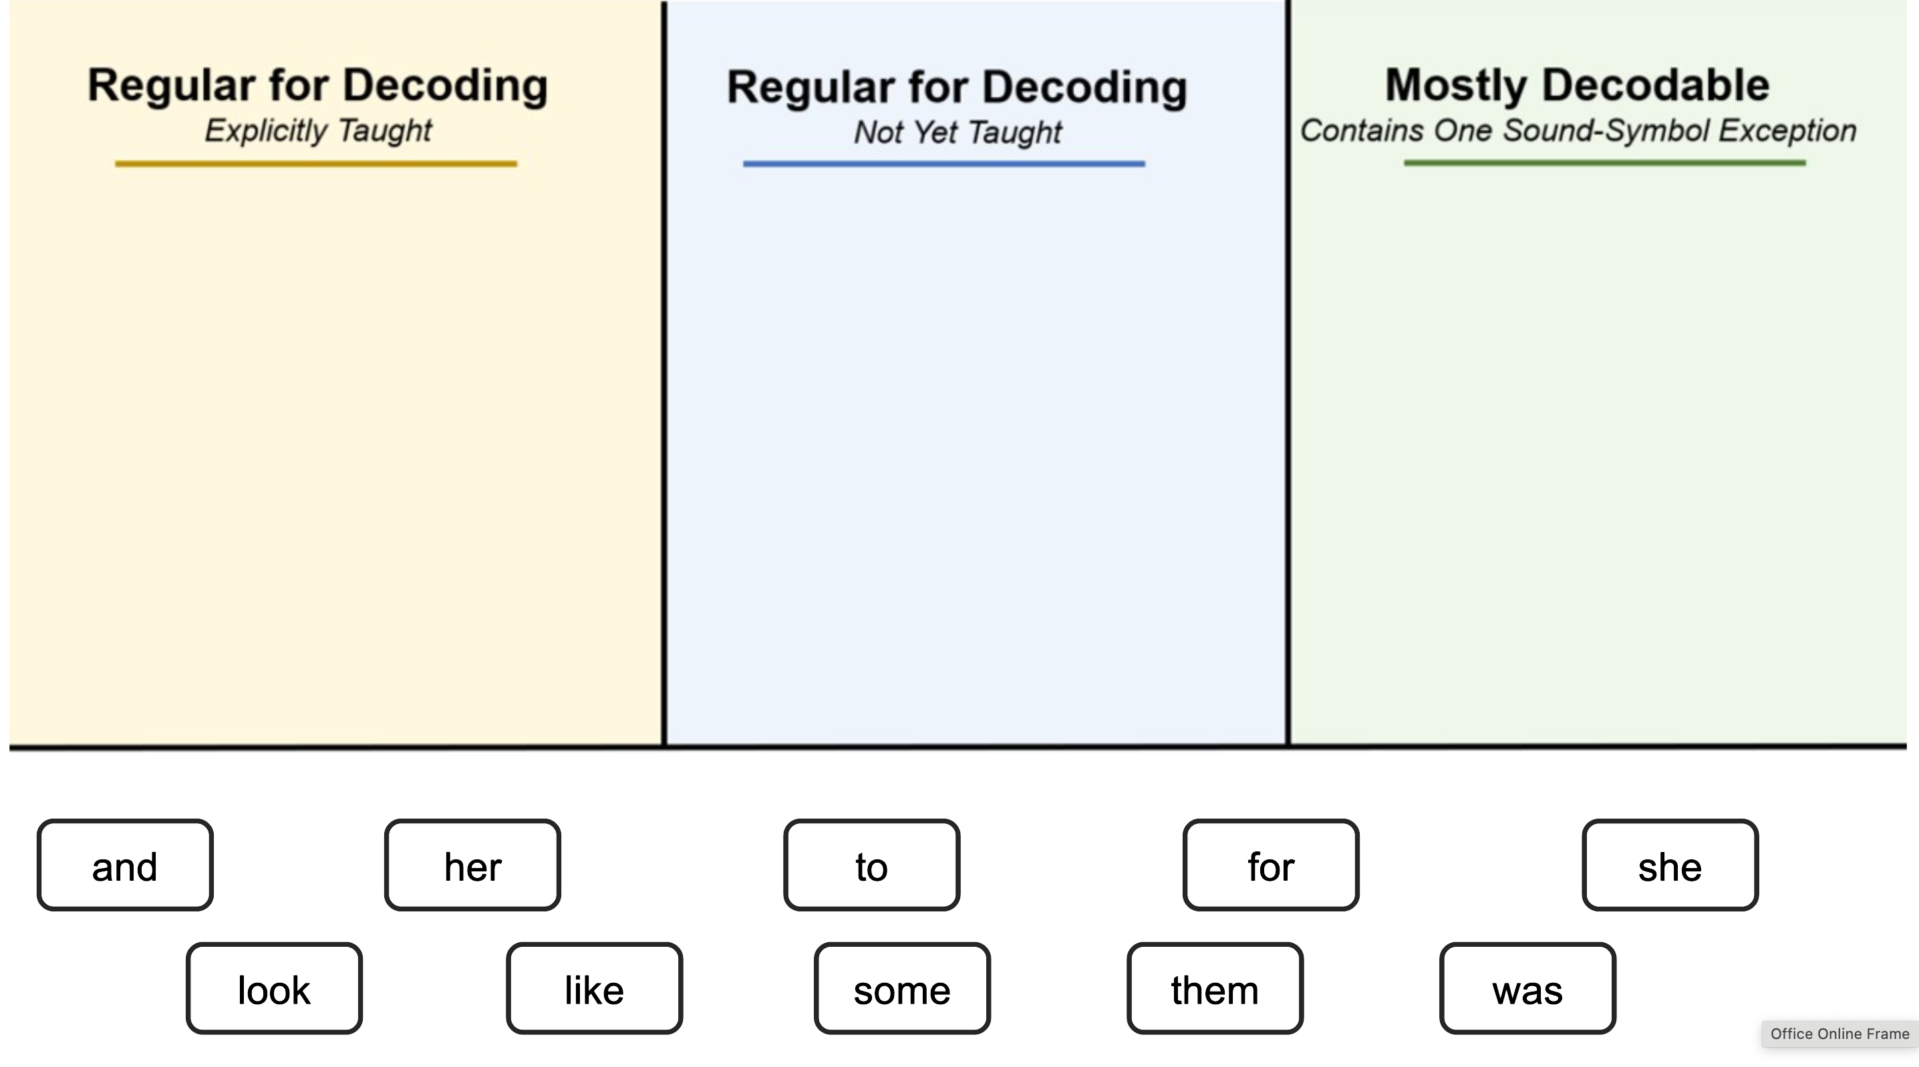
Check Your Learning

Slide 29
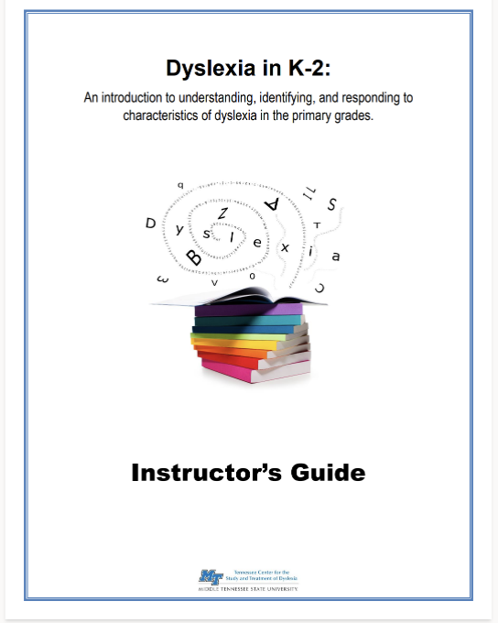
Instructor’s Guide

Slide 30
Looking ahead
Evaluate implementation
Revise existing content
Expand offerings for MTSU COE
Work with external partners
Data on implementation models

Slide 31
Questions?
Thank you!
karen.kehoe@mtsu.edu
(615) 494-8885

