Slide 1
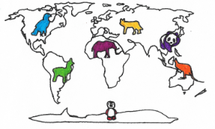
Materials for North America Unit
Table of Contents
Book 2- North America by The Project Ready! Team……Found on Website
Book 3- Ten on the Sled Counting Cards ………………………25
Book 11- Bear Snores On Rhyming Cards ………………….….27
Book 12- Counting Crocodiles Counting Cards ………………..28
Book 13- The Mitten Craft Templates …………………………..35
(from JanBrett.com)
Book 16- Big Red Barn Rhyming Cards ……………………….38
Book 17- Way Out in the Desert- Counting Eye Spy …………..39
Book 18- See How They Grow- Frog Craft Template ………….40
Dramatic Play Center: Nature Center
Scientists and Tools Cards………………………………….41.
North American Animal Habitats Book ……………………44
Frog Life Cycle Cards ……………………………………..49
Salamander Life Cycle Cards ………………………...........51

Slide 2

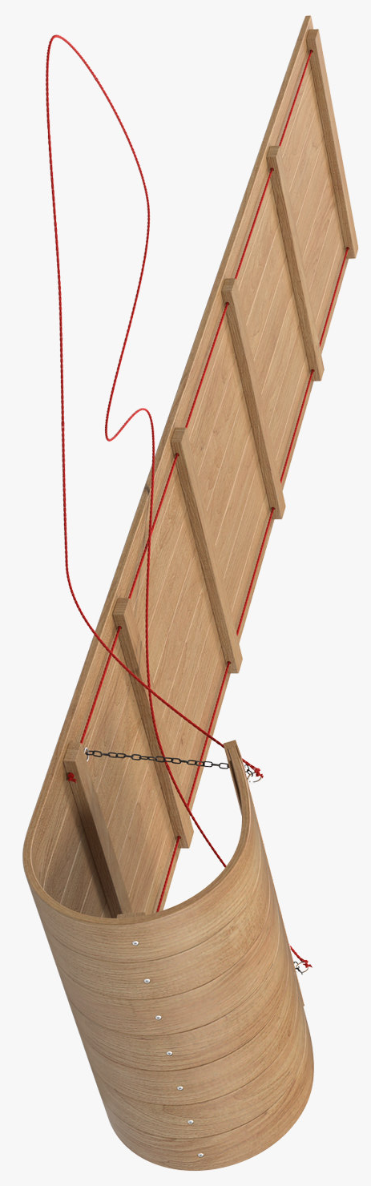
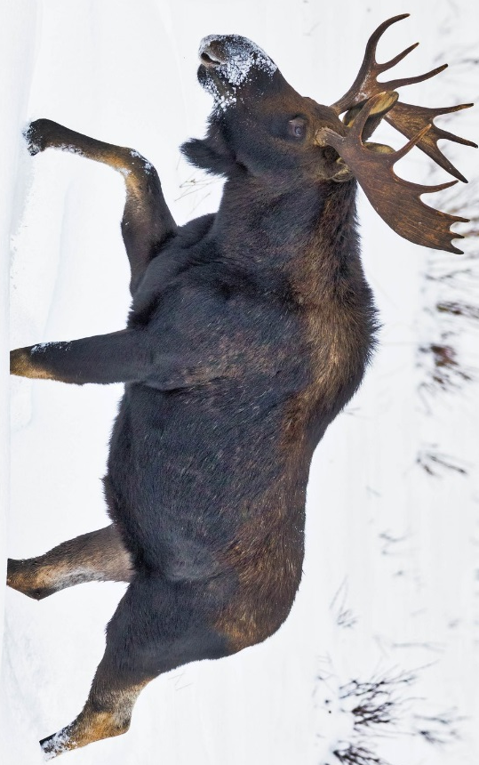

Slide 3
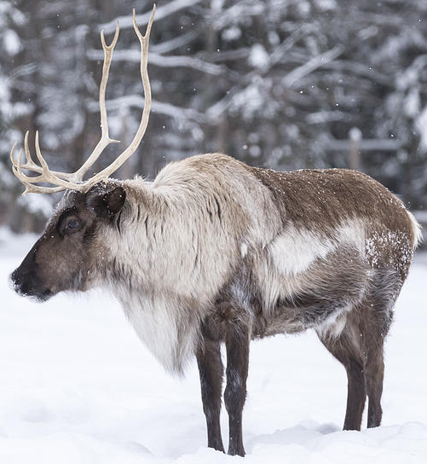
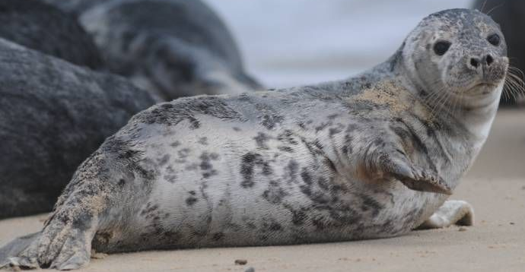
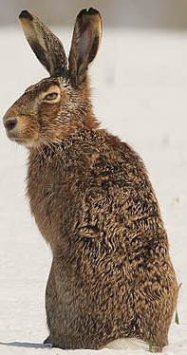
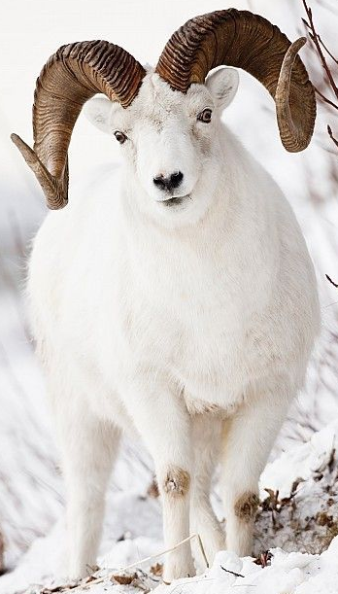
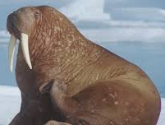
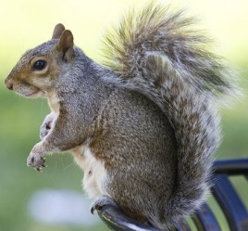
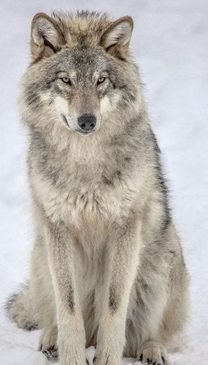
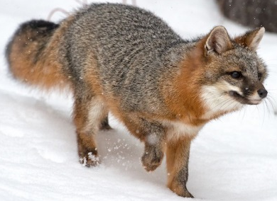

Slide 4
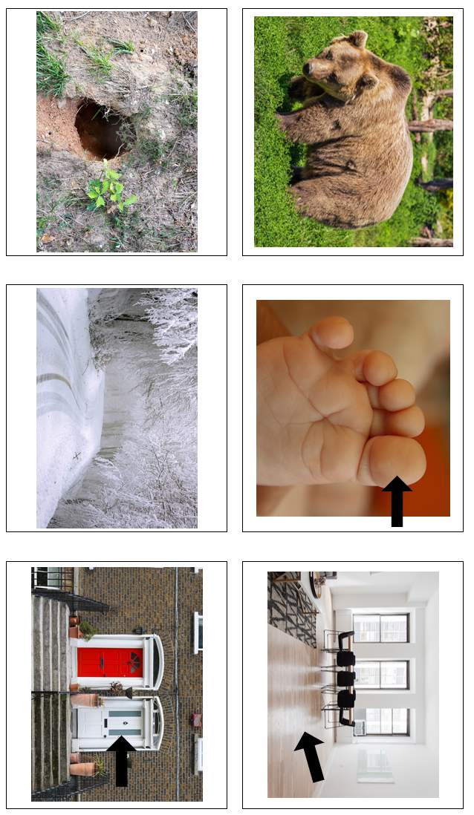
Book 11- Bear Snores On Rhyming Cards
bear, lair toe, snow floor, door

Slide 5
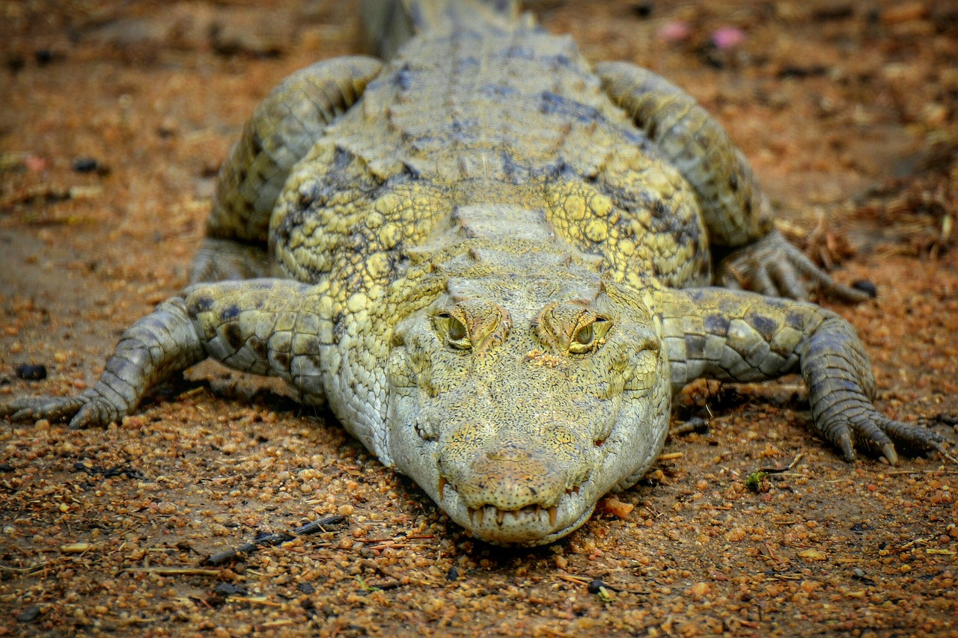
Book 12- Counting Crocodiles Counting Cards

Slide 6
Book 12- Counting Crocodiles Counting Cards

Slide 7
Book 12- Counting Crocodiles Counting Cards

Slide 8
Book 12- Counting Crocodiles Counting Cards

Slide 9
Book 12- Counting Crocodiles Counting Cards

Slide 10
Book 12- Counting Crocodiles Counting Cards

Slide 11
Book 12- Counting Crocodiles Counting Cards

Slide 12
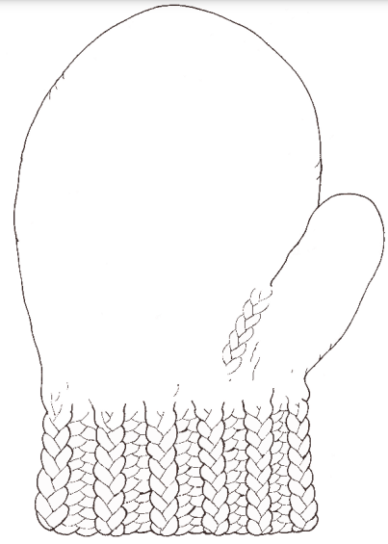

Slide 13
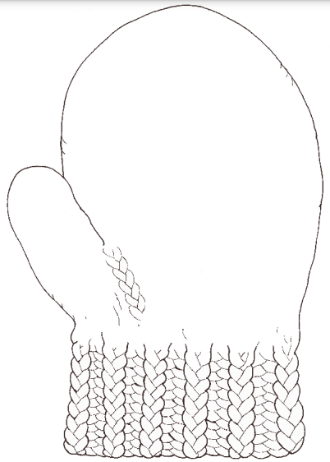

Slide 14
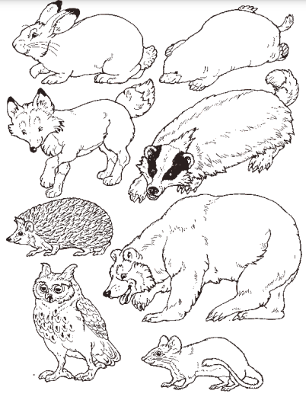

Slide 15
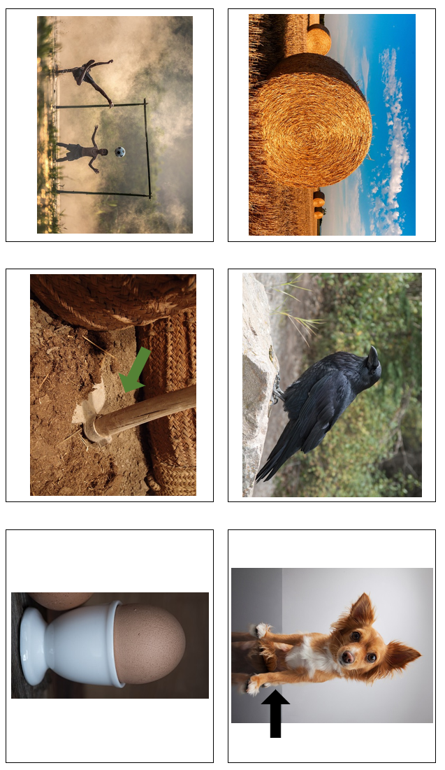
Book 16- Big Red Barn Rhyming Cards
hay, play crow, hoe leg, egg

Slide 16
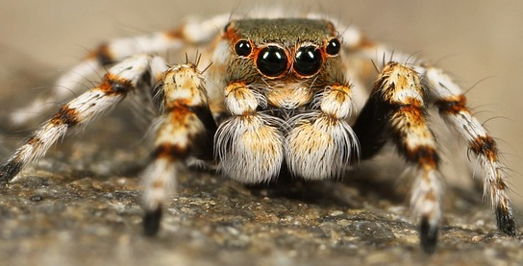
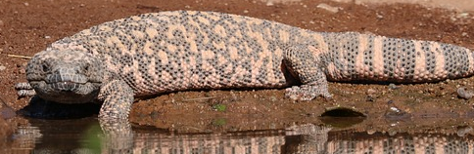
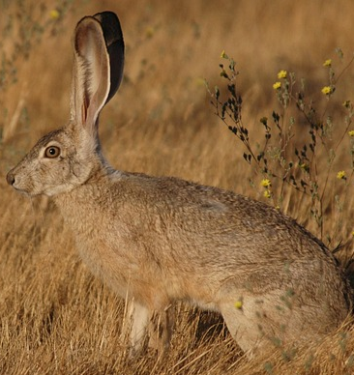
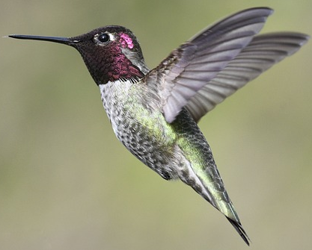
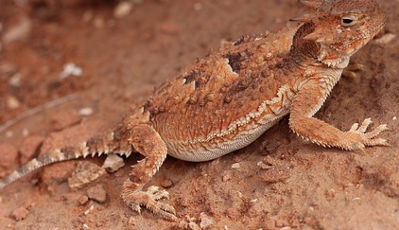
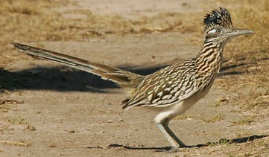
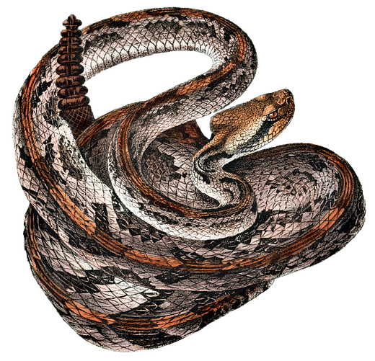
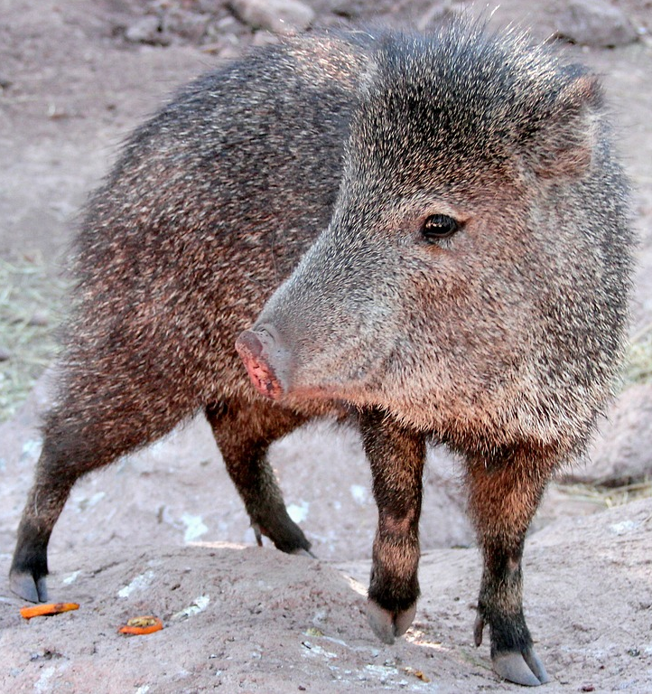
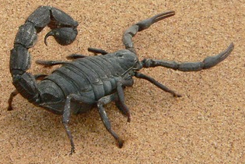
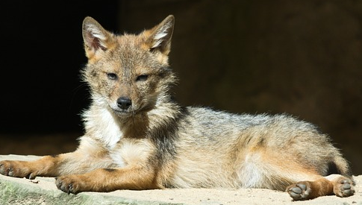
Book 17- Way Out in the Desert Counting Eye Spy

Slide 17
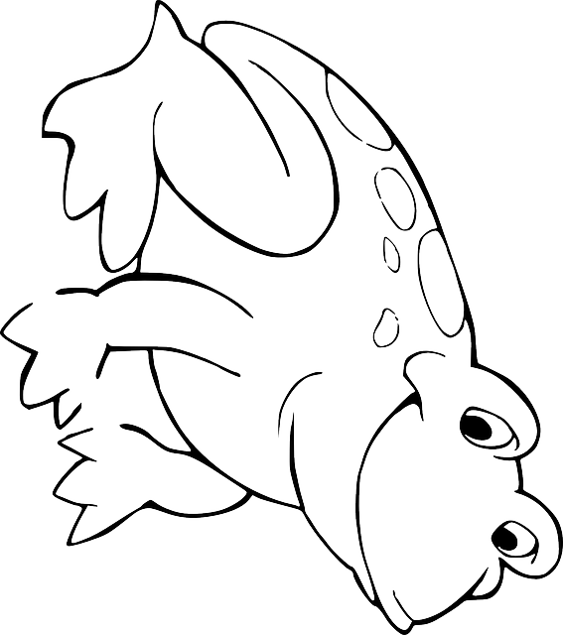

Slide 18

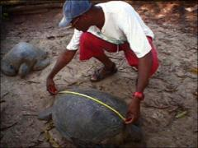
Book 10- What is Science? Scientists and Tools Cards
Nature Center
(tweezers and measuring tape)

Slide 19


Book 10- What is Science? Scientist and Tools Cards
Nature Center
(dropper and microscope)

Slide 20


Book 10- What is Science? Scientist and Tools Cards
Nature Center
(binoculars and magnifying glass)

Slide 21


Slide 22
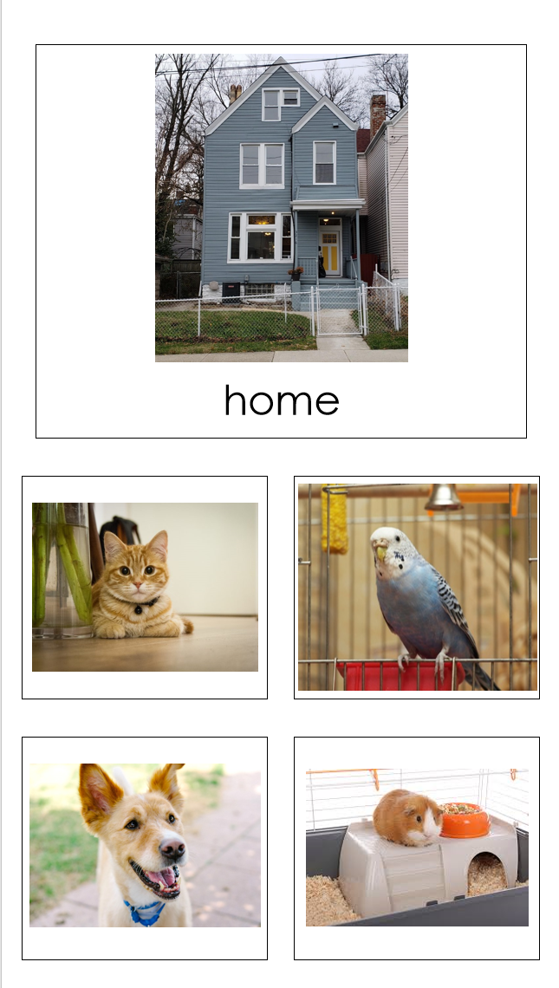

Slide 23
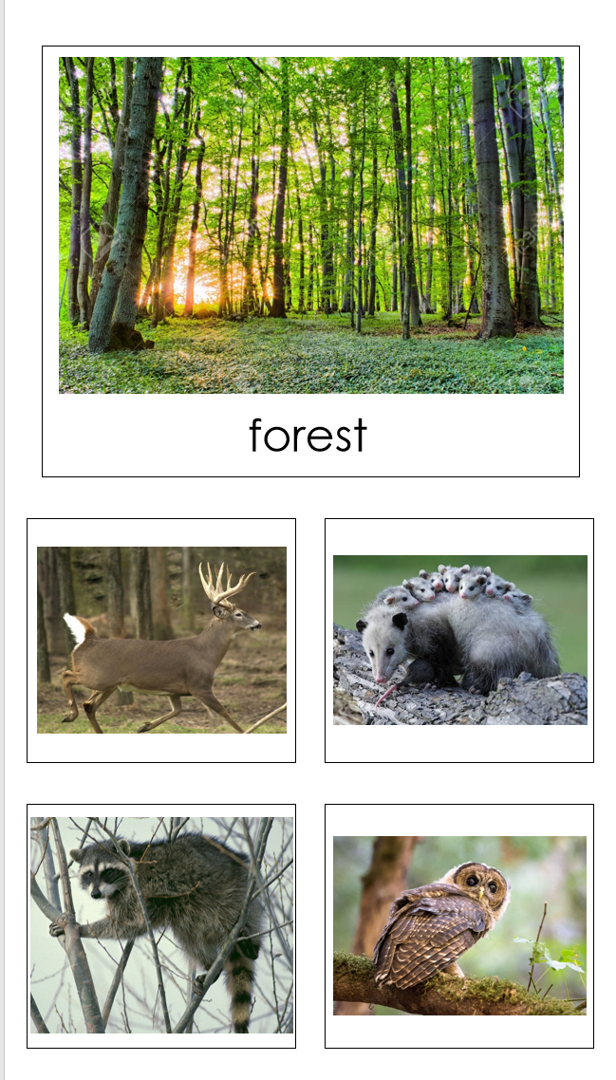

Slide 24
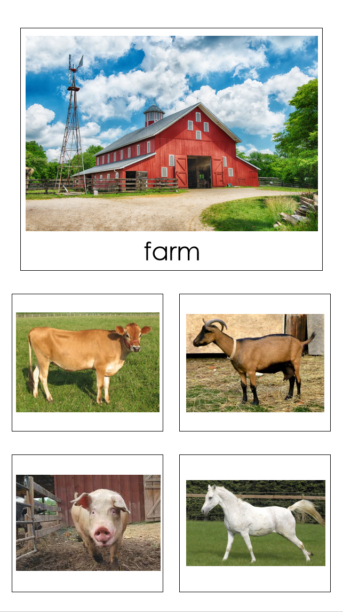

Slide 25
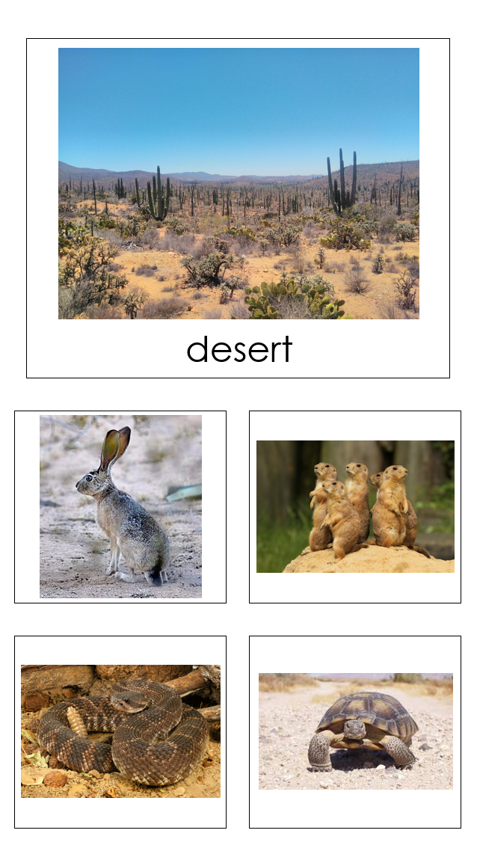

Slide 26
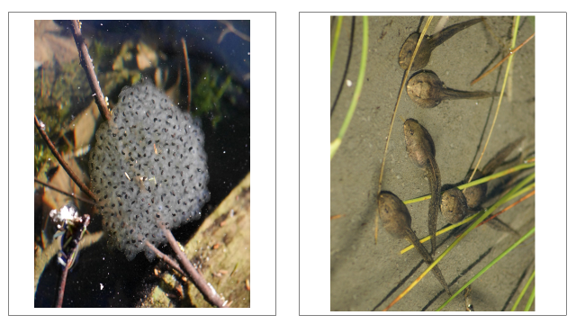
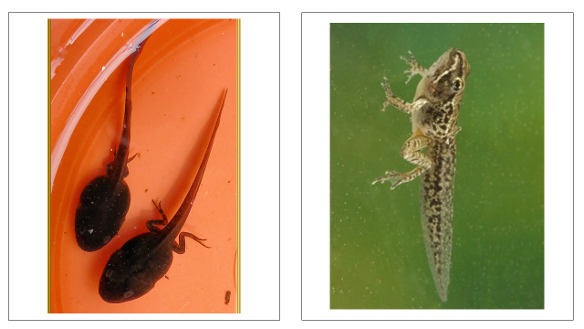
Book 19- See How They Grow- Frogs Life Cycle Cards
Nature Center

Slide 27
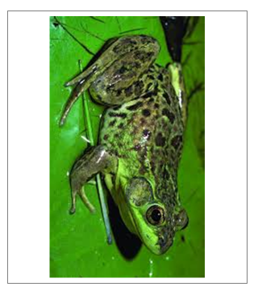
Book 19- See How They Grow- Frogs Life Cycle Cards
Nature Center

Slide 28
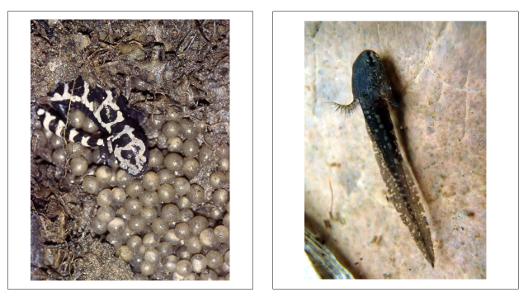
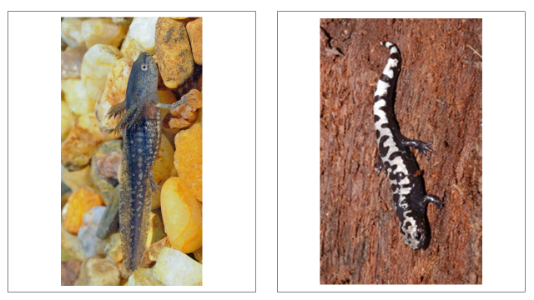
Book 20- The Salamander Room Life Cycle Cards
Nature Center

