Slide 1
Ocean Animals
Object-to-Picture Match
Directions:
Print picture cards
Cut and laminate into individual cards
Match picture cards to small animal figurines
Place picture cards and animal figurines into a basket. This makes it easy to contain all the pieces and easy to access for students.
Show students how to lay out cards and match each figurine to a card. Name each ocean animal while matching.
Place this activity in Dramatic Play Center (Nature Center: Ocean Animal Exploration) so students can do this activity independently while playing there

Slide 2
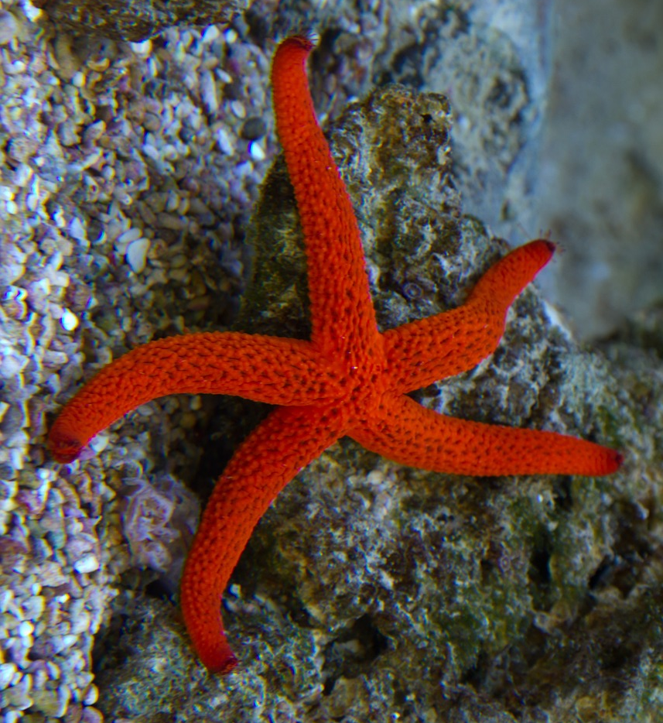
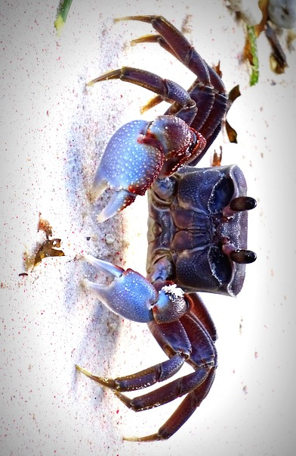
Object to Picture Match: Ocean Animals
sea star
crab

Slide 3
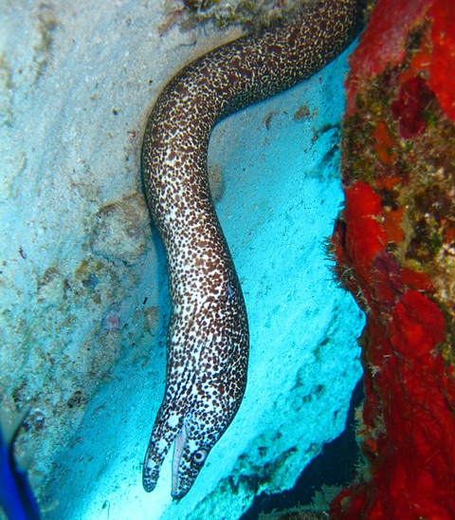
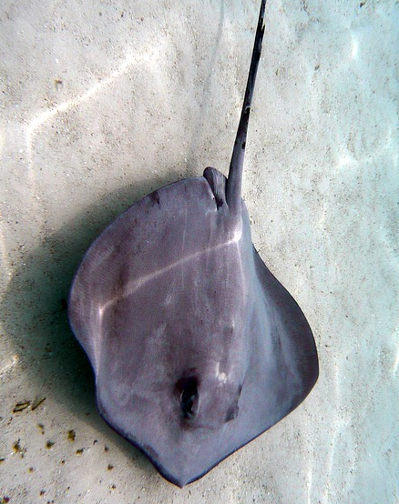
Object to Picture Match: Ocean Animals
eel
stingray

Slide 4
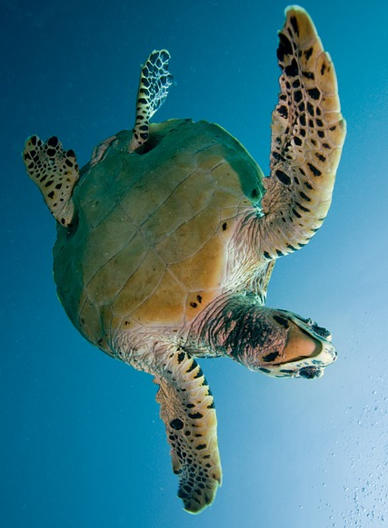
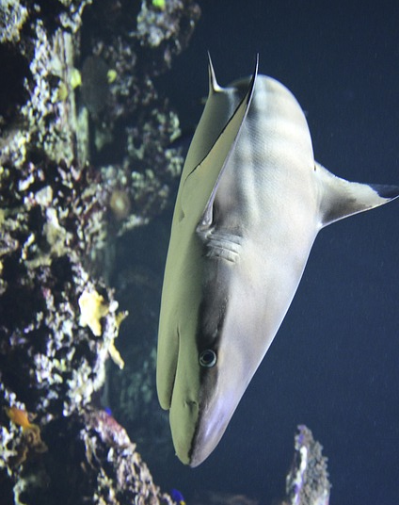
Object to Picture Match: Ocean Animals
sea turtle
shark

Slide 5
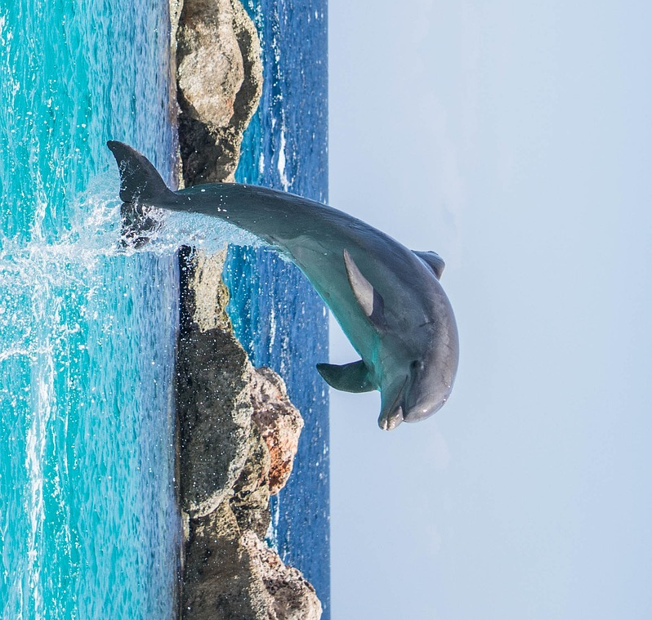
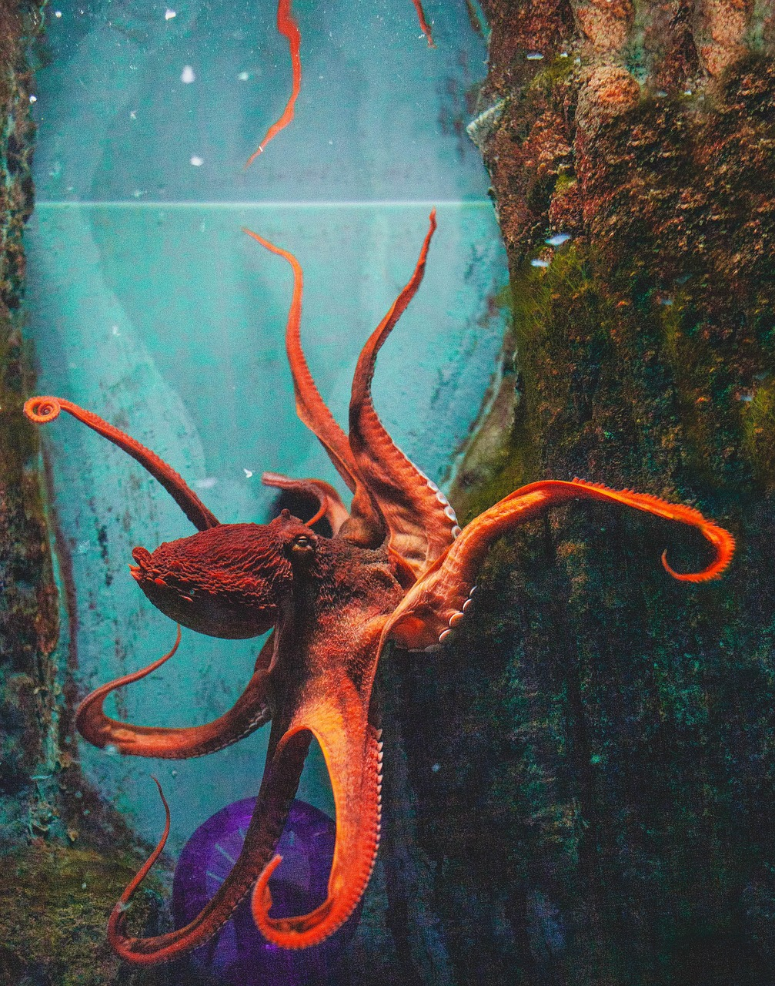
Object to Picture Match: Ocean Animals
dolphin
octopus

Slide 6
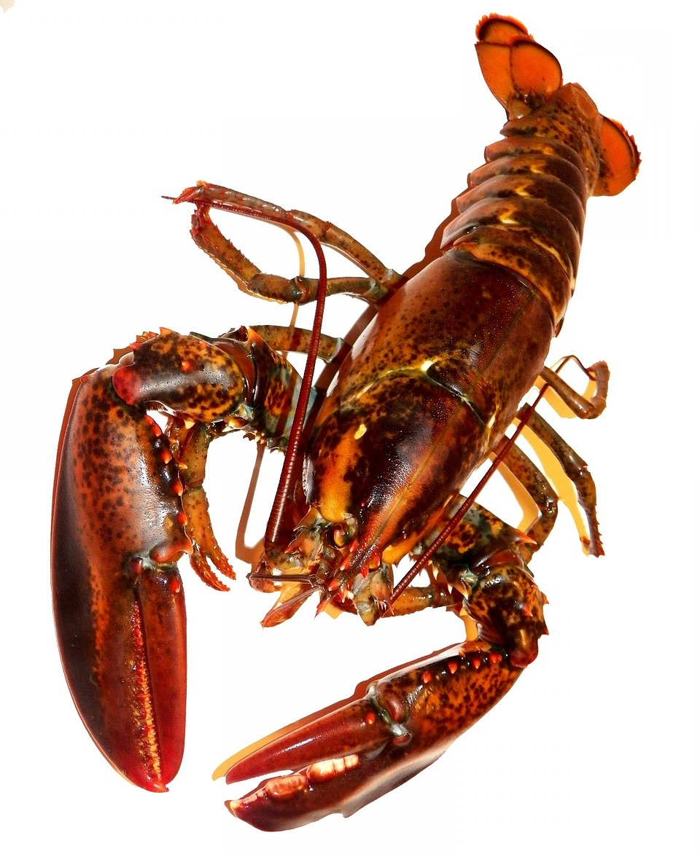
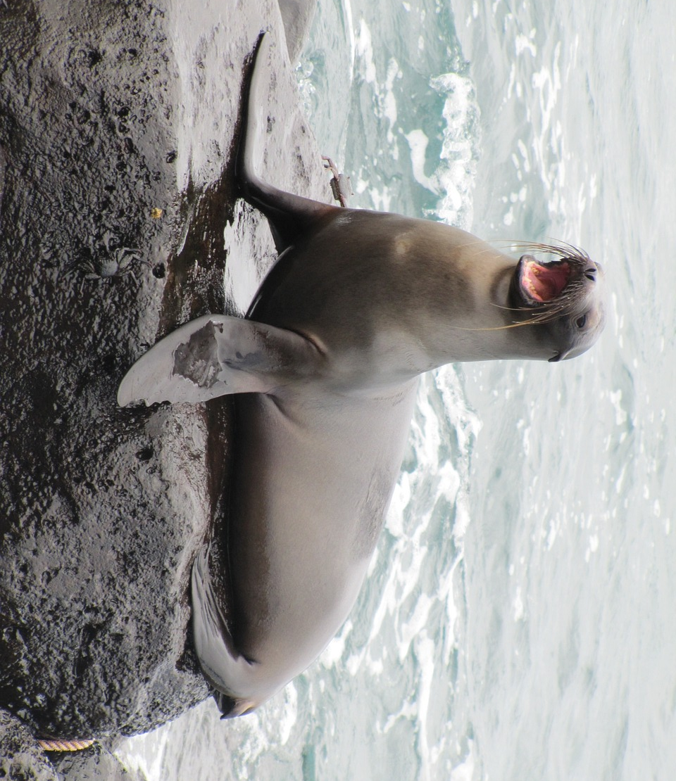
Object to Picture Match: Ocean Animals
lobster
sea lion

Slide 7
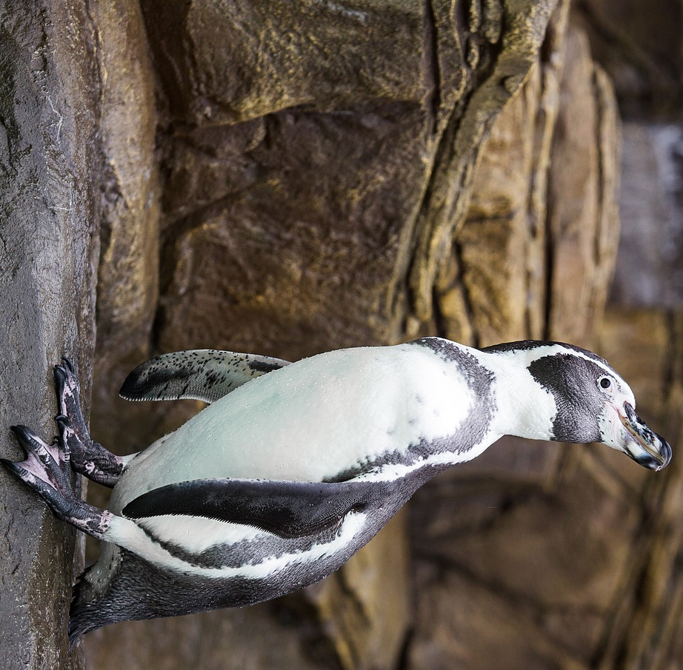
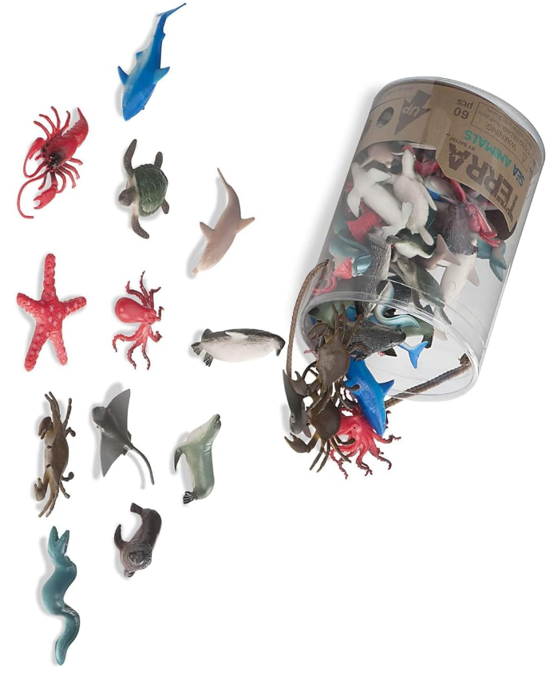
Object to Picture Match: Ocean Animals
penguin
ocean animals

