Slide 1
Alphabetics
A a
A a
Review: Letter Statue Game Cards

Slide 2
Stand on 1 foot
A a
Stand on 1 foot

Slide 3
Jump
A a
Touch Your Toes
A a

Slide 4
Jump
A a
Touch Your Toes
A a

Slide 5
Sit Down
A a
Turn Around
A a

Slide 6
Sit Down
A a
Turn Around
A a

Slide 7
a
A
A a
A a

Slide 8
C
A a
c
A a

Slide 9
G
A a
g
A a

Slide 10
E
A a
F
A a

Slide 11
e
A a
f
A a

Slide 12
h
A a
H
A a

Slide 13
I
A a
i
A a

Slide 14
V
A a
v
A a

Slide 15
Y
A a
y
A a

Slide 16
K
A a
L
A a

Slide 17
k
A a
l
A a

Slide 18
J
A a
j
A a

Slide 19
M
A a
m
A a

Slide 20
O
A a
o
A a

Slide 21
Q
A a
q
A a

Slide 22
r
A a
R
A a

Slide 23
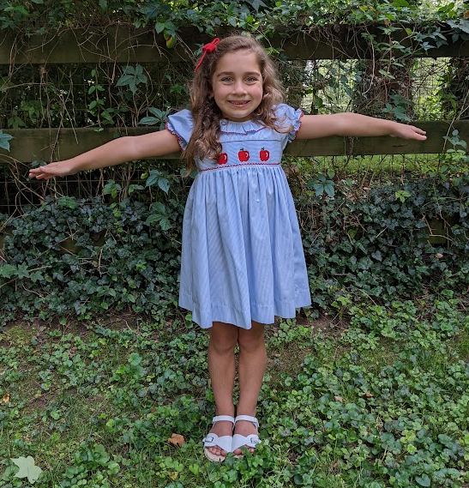
t
A a
T
A

Slide 24
U
A a
u
A a

Slide 25
z
A a
Z
A a

